Slide 1
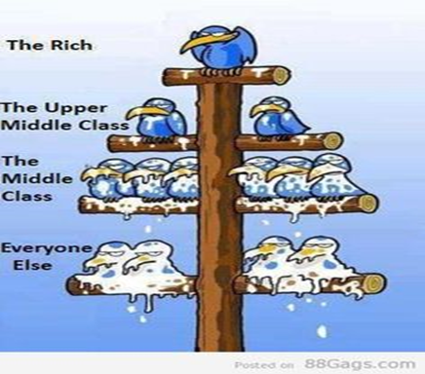
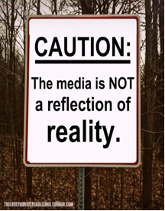
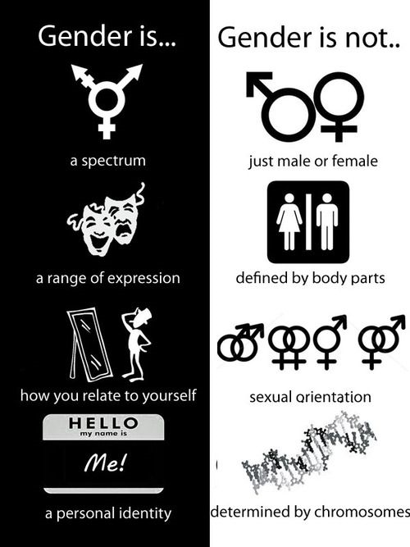
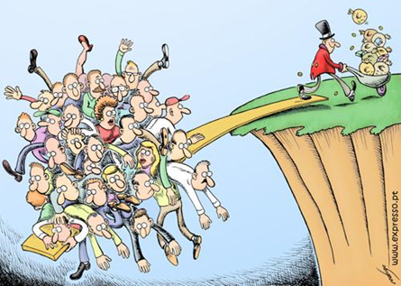
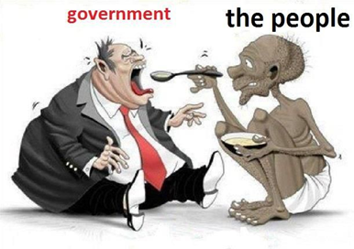
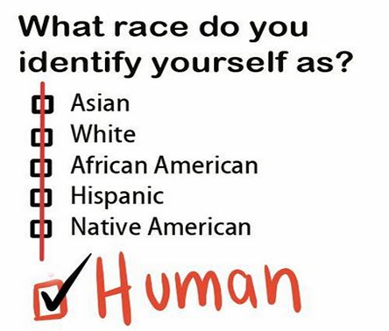
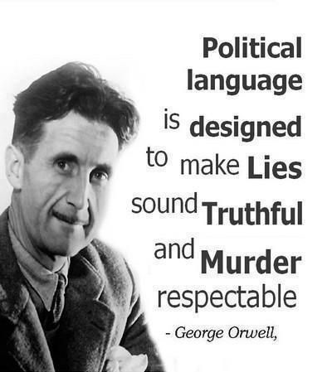
Year 11 Transition Booklet
We follow the AQA A-level specification
If you have any questions over the summer email

Slide 2
Topics we Cover:
Family | Education | Theory & Methods | Media | Crime
Theories Functionalism Marxism Feminisms Personal Life Postmodernism Govt Policies | Perspectives Functionalism New Right Marxism Conflict Views Vocational Education | Perspectives Functionalism Marxism Feminisms Postmodernism Social Action | Perspectives Marxism Neo Marxism (GUMG) Pluralist Neo-Philliac Cultural Pessimist Postmodernism | Theories Functionalism Marxism & Neo-Marxism Interactionism Control Theory Realist Theory
Diversity: Family Structures Marriage Divorce Cohabitation Child Bearing Types of Diversity Life Course Analysis | Differential Achievement Social Class Gender Ethnicity | Research Design Practical Considerations Ethics Theoretical Considerations | Ownership + Control of the Media 1.What are the media? 2. Formal controls on the media 3. Government influence 4. Ownership 5. Media and ideology / control of content | Social Distribution Statistics Gender Ethnicity Locality Social Class
Changing Roles Gender Roles Domestic Division of Labour Decision making Power Relations Domestic Violence | Relationships & Processes Organisation of teaching and learning Labelling Subcultures Teachers Curriculum and Subject Choice | Sources and Types of Data Social Surveys Interviews Observations Experiments Official Statistics Quantitative – Qualitative Primary - Secondary | Globalisation and the Media Globalisation and popular culture Postmodernist view of the media | Globalisation Globalisation Mass Media Green Crime State Crime
 |  |  | Social Construction of the News
Childhood Social Construction State of Childhood Future of Childhood | Educational Policies Independent Schools Tripartite School Comprehensivisation Marketisation Recent Policies | Sampling Random Systematic Stratified Quota Snowball | Media Representations Age; Class; Ethnicity; Disability; Gender; Sexuality | Control and Prevention Right Realism Left Realism Punishment CJS Prisons Victimology
 |  |  | Media + Audience Media effects model Passive / Active audiences Violence and the media
Demographics Birth Rates Infant Mortality Death Rate Life Expectancy Aging Population Family Size Migration |  | Debates Factors affecting research Interpretivism V Positivism Value Freedom Sociology as a Science Sociology and Social policy.
 |  |  | New Media 1.Who uses new media? 2. Stratification and new media 3. Effects of new technologies 4. Significance of new media in contemporary society

Slide 3
How the Course is Assessed:
There is no coursework in Sociology.
Students sit exams at the end of Year 12 and Year 13. AQA Sociology A-level is a linear course. AS or Year 12 helps you develop the key critical skills, thinking and social comprehension. Whereas as Year 13 allows you to practice these skills and complete your Sociological Imagination.
We focus particularly on how certain features of a person’s social position (i.e. their gender, social class and ethnicity) might affect their LIFE CHANCES in society.
Sociology is regarded as a Social Science, largely because it uses a number of research methods to examine society in more detail.
A major part of gaining success in Sociology is by learning the main ideas, concepts and terms used – the language of the subject – and then being able to use this language when you are discussing the topics and issues relevant to the study of society.
Year 12
Paper One: | Paper Two:
Education Methods in Context - 50% of AS Level | Research Method Families and Households - 50% of A Level
Year 13
Paper One: | Paper Two: | Paper Three:
Education Methods in Context Theory and Methods - 33% of A Level | Families Media - 33% of A Level | Crime and Deviance Theory and Methods - 33% of A Level

Slide 4
Sociology is…
The study of society, large groups of people and individuals.
It studies how and why people behave the way they do in society
Looks at how structures such as family and Government influence human behaviour
A social science which uses research to investigate and predict human behaviour to help governments improve the lives of its citizens
A critical and radical subject, it is about questioning why society is as it is. It is about digging under the surface, looking at what is really going on.
Is sociology for me?
Yes, if you’re interested in questions like these…
Why are some people rich and some people poor?
Are children and young people treated unfairly in society?
Are people successful because of their background or how hard they work?
Why are some of the hardest jobs poorly paid?
Why are a large proportion of MPs white, male and from private schools?
Would the world be happier if there was just one religion?
Sociology is NOT...
An easy subject
Just common sense
Wishy-washy and unscientific
Psychology

Slide 5
What kind of Sociologist will you be?
1. The defining characteristic of human behaviour is:
A) Their gender/ sex
B) Their social class
C)Their Race
D) Their integration into society
E) Their culture
2. We have the freedom to choose our own behaviour
A) Yes
B) No
C) Depends
D) Doesn’t matter
E) What is freedom?
3. What are your views on the family….
A) Family is oppressive to women and teaches us to conform to gender roles
B) Family is a tool of the ruling class teaching us to obey authority
C) Family is a vital part of socialisation that teaches us norms and values
D) Family is what you make it, everyone has a different view on it
E) Family – what is a family? You can’t define it
4. When it comes to inequality
Gender is the most serious issue!
Money and power the rich exploit the poor!
Inequality is normal part of society
Inequality is a label that has different meanings to people
You make your own reality up
5. When it comes to Crime
The justice system is more lenient on women
Criminal laws protect the rich and powerful
Crime is good for society as it reminds us of the rules
Crimes are actions labelled as wrong to influence our behaviour
Crime – what is a crime? Can we really define what a crime is?
6. When it comes to religion
Religion oppresses and controls women – telling us to cover up and be obedient
Religion is a tool used by those with power to control us
Religion is a useful institution which unites people who share a common set of beliefs
Religion means different things to different people
Religion is just another meta-narrative (big story) people use to explain reality

Slide 6
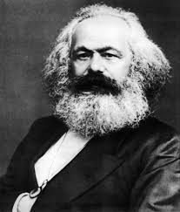
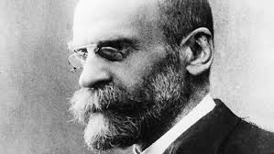
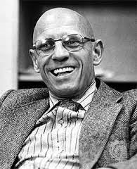
What kind of Sociologist will you be?
Mostly A – Our Feminist
You are most likely to turn into our Feminist Sue Sharpe. Feminism looks at how society is structured in a way that benefits men while oppressing women – this is known as patriarchy (male domination.). The theory is often a misunderstood as stereotypes and misconceptions about it exists. Many people do not realise that there are several types of feminism such as black, radical feminism and liberal.
Mostly B – Our Marxist
You are most likely to turn into Karl Marx. Marxism looks at how society is constructed is a way that produces class conflict with the rich having all the power and control whilst the poor are oppressed. Marx argues that the root cause of class inequality is down to capitalism as it encourages people to be greedy and materialistic. Just as capitalism replaced feudalism, Marx argues that capitalism will one day be replaced with communism
Mostly C- Our Functionalist
You are most likely to turn into Emile Durkheim. Functionalism is theory which argues that members of society are united together by a shared set of idea and beliefs called ‘norms’ (normal behaviour.) These norms are accepted by all members in society and are enforced by structures such as family and education. They see society like a human body – with all parts needed in order for it to ‘function’ and work effectively.
Mostly D- Our interactionist
You are most likely to turn into Becker/ Mead. Interactionism looks at how people create meaning during social interactions, how they present and construct the self (or identity) as well as how they define situations. One of the perspectives key ideas is that people act the way they do because of how they define situations. Becker uses the example of nudity to illustrate how timing, place and audience can influence how people see an action or idea.
Mostly E – Our post-modernist
You are most likely to turn into Foucault. Post-modernism is a more recent Sociological theory which seeks to question and de-construct existing structures and understandings of reality. Post modernism rejects the idea that one theory such as functionalism, Utilitarianism, religion or even science can explain reality!

Slide 7
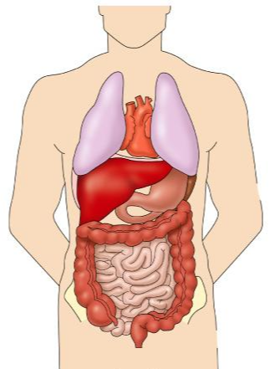
Theory is a big part of Sociology!
Task 1: Functional Functionalists…
Write Definitions for Free Will and Determinism.
Research Functionalism and produce a fact sheet outlining the “Organic Analogy
Do some further research on Functionalism
Write a paragraph on the strengths on the theory
Write another on the weaknesses of the theory

Slide 8
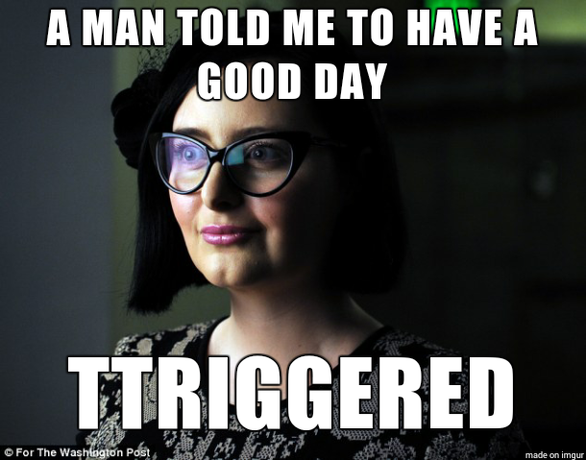
Task 2: Fiery Feminists…
Watch youtube clip: https://www.youtube.com/watch?v=LHPOLSywdi0 Define all key words from the video clip. Research Feminism and produce a fact sheet outlining the definitions and provide examples. 3. Research @ or #EverydaySexism What is the project? What examples do they give of modern sexism? Do you think sexism is still a problem today? Why? Do ALL women have the experience? Explain you answer? Explain!
Research examples of gender inequality within the UK in contemporary society.

Slide 9
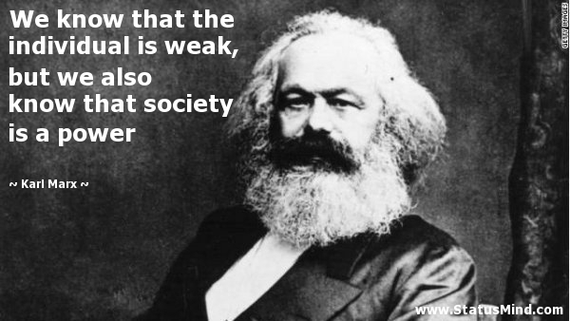
Task 3: Magnificent Marxists…
Watch YouTube clip: https://www.youtube.com/watch?v=Vz3eOb6Yl1s
Define all key words on the video clip. Research Marxism and produce a fact sheet outlining the difference between the bourgeoisie and the proletariat. Research examples of class inequality within the UK in contemporary Society. Choose one of the examples and explain how a Marxist would interpret the situation How would a functionalist counter this approach?

Slide 10
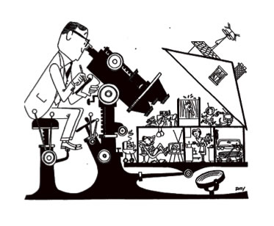
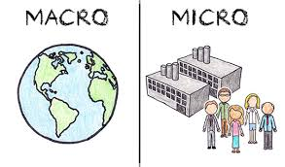
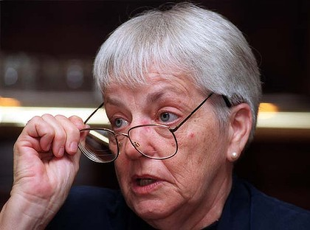
Task 4: Autonomous Social Action Theorist…
Functionalism | Feminism | Marxism
Complete a Summary table for your notes outlining each approach and stating whether they are:
Consensus or Conflict Theories
Macro or Micro Approaches
Structural or Social Action
Ensure that you define which words in bold go with which theory! Add the strengths and weaknesses of each to the table too!
Watch the following you tube video: https://www.youtube.com/watch?v=yJrnwOPC2f8 Define Social Action Theorist approach to society.
Do you think we have free will within society? What perspective would Social Action Theorist take on this question?
How would a structuralist respond to the idea of free will? Do you agree? Explain

Slide 11
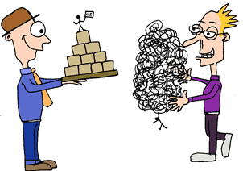
Task 5: Passionate Post-modernists…
Watch the following YouTube video:
https://www.youtube.com/watch?v=QqsP0vQJJ44
Produce a factsheet outlining what post-modernism is and what it says about society
Produce a table outlining the differences between a modern and post-modern society. (you may need to do more research!)
Find examples of post-modern changes in society within the Media. For example Same Sex Marriages in the USA.
4. Do some further research on Functionalism
Write a paragraph on the strengths on the theory
Write another on the weaknesses of the theory
5. Out of the 5 theories you have researched - Which Sociological theory do you most and least agree with and why? Explain your reasons in detail making sure you explain what it was about that particular theory (at least a side of A4)!
Modern | Post-Modern

Slide 12
There are a lot of key terms that you need to know for your exams and to make sure you write great essays! Lets start off with the basics:
Task 6: define the following sociological key terms:
1. Norms
2. Values
3. Socialisation
4. Society
5. Culture
6. Identity
Now for each of the key terms add a picture and an example to go with them
7. Social differentiation
8. Stratification
9. Status
10. Subculture
11.Cultural diversity
12. Consensus
13. Conflict
Task 7:
As a sociology student you will also be expected to keep up to date with the news and current events – research a social issue that interests you!
Explain what why that particular issue (what interests you about it?)
Create a media collage of articles on your issue and annotate them
Apply what the theories might say about the issue!
Any research or policy laws which deals with your issue? Name and explain them!
Task 9: How do you see society? Draw (or build a model) of how you view society (use shapes / key words / images where possible) Provide a written explanation of your work (At least a side of A4) to explain your work.
What are main issues/ problems/ solutions you feel as a society we face and why!
Task 10: watch some TV!
Sociology is everywhere, so you’ll be able to see aspects of it in all forms of media. Try searching for the following titles and make notes on any videos you watch, try to keep it relevant to the topics taught in Sociology (see above).
School Swap documentary
Stacey Dooley documentaries
(BBC iPlayer/YouTube)
Black Mirror (Netflix)
Reggie Yates documentaries
Dispatches documentaries (4OD)
Panorama documentaries (BBC iPlayer)

Slide 13
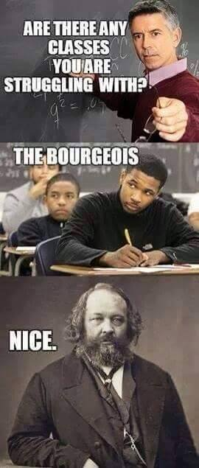
Useful Resources & Further Reading
To help you on your way…
It is also recommended that you take an active interest in the news and what is going on around you in the wider world as a lot of the concepts and ideas covered in lessons will relate to what is going on. The ability to be able to draw upon contemporary examples will also help illustrate your application and understanding skills which will be vital in order for you to achieve the higher grades in this subject.
Websites:
AQA New Specification – http://www.aqa.org.uk/subjects/sociology/as-and-a-level/sociology-7191-7192/introduction
AQA - Example Assessment Material -http://www.aqa.org.uk/subjects/sociology/as-and-a-level/sociology-7191-7192/assessment-resources
S-Cool Revision Materials - http://www.s-cool.co.uk/a-level/sociology
Every Day Sexism Project -http://everydaysexism.com/index.php/about
Who Needs Feminism - http://whoneedsfeminism.com/about.html
He for She Campaign - http://www.heforshe.org/
https://www.tutor2u.net/sociology/reference http://politybooks.com/kenbrowne/resources.asp
https://napierpress.com/book-one-workbooks
https://napierpress.com/book-two-workbooks
http://www.earlhamsociologypages.co.uk
https://www.sociologystuff.com
For your first lesson… We expect you to have the following:
A level arched folder – labelled with your name on and Sociology (spelt correctly).
There must be dividers in your folder – plastic ones are better as they are tougher.
Your own lined paper • Plenty of plastic wallets. • A pencil case with the usual but we use a lot of post-it notes and highlighters so have plenty of those.
A copy of the Year 1 textbook
Your task homework contained in this booklet.
Well done! You’re all set ready to embark on your Sociology A Level course.

