Slide 1
Maths Rich Task : Function Machines

Slide 2
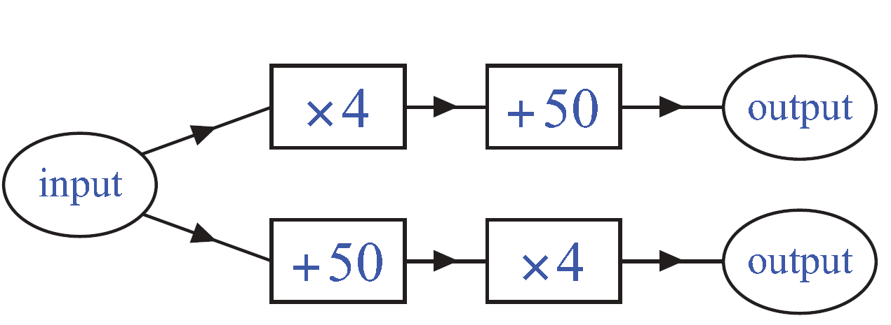
Function Machines: Instructions
Choose a number to put into this function machine and make a note of the two outputs:
Now try another number, and then another.
What do you notice?

Slide 3
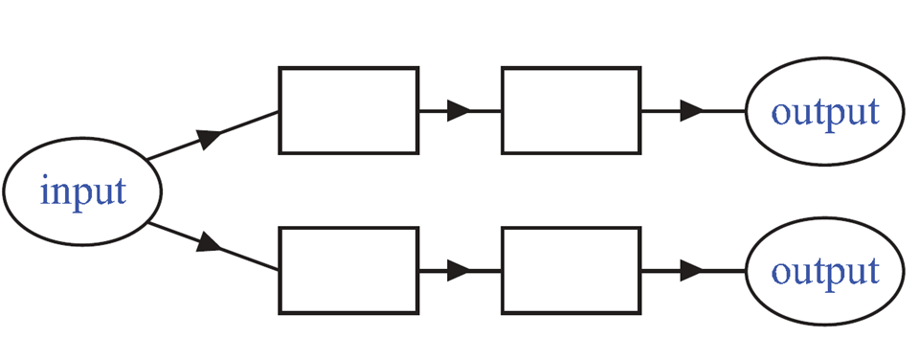

Slide 4
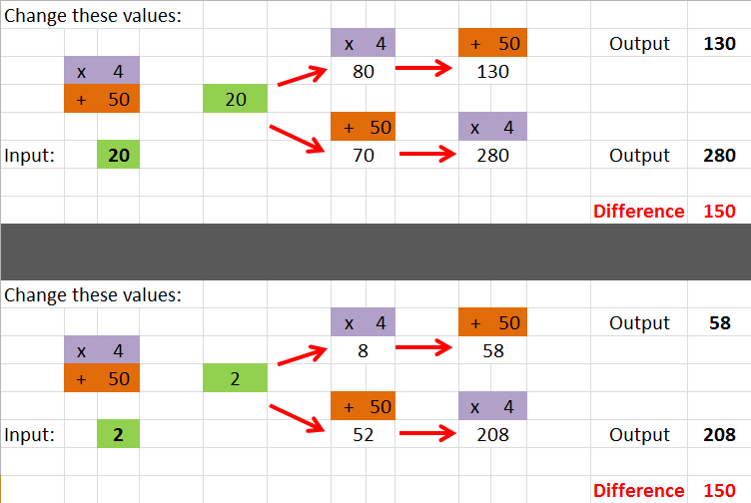
Excel Function Machine Checker

