Slide 1
Maths Rich Task How many quadrilaterals?

Slide 2
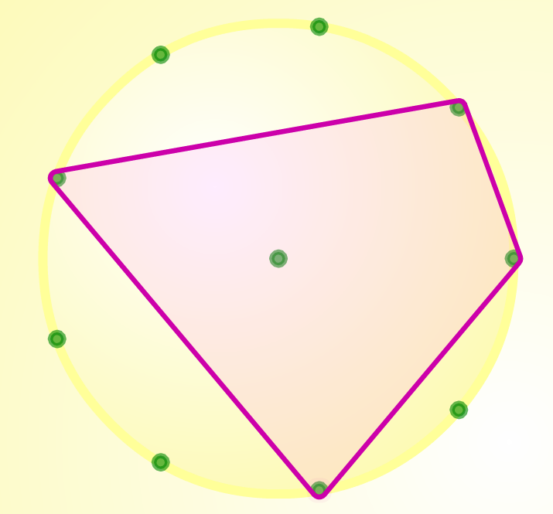
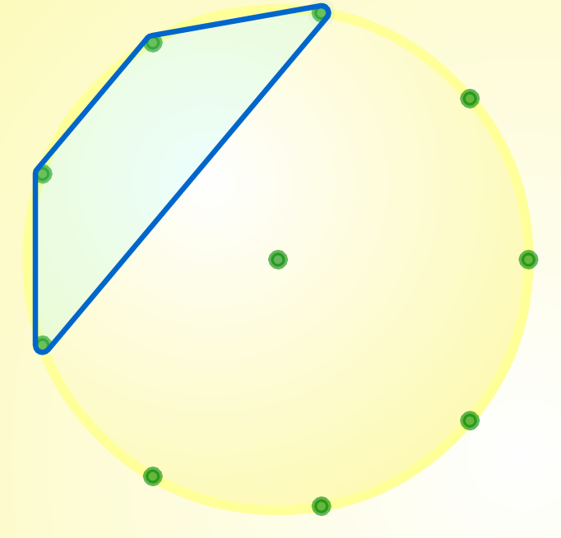
How many quadrilaterals: Instructions
How many different quadrilaterals can you make on a 9 pin geoboard?
Each side must be connected by a dot on each end
Each corner/vertex must lie on the outside of the circle

Slide 3
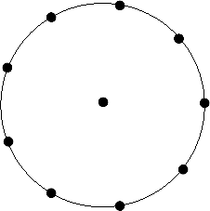

Slide 4
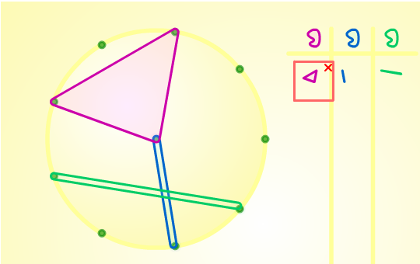
Virtual Geoboard:

