Slide 1
Maths Rich Task : Multiplication Reduction

Slide 2
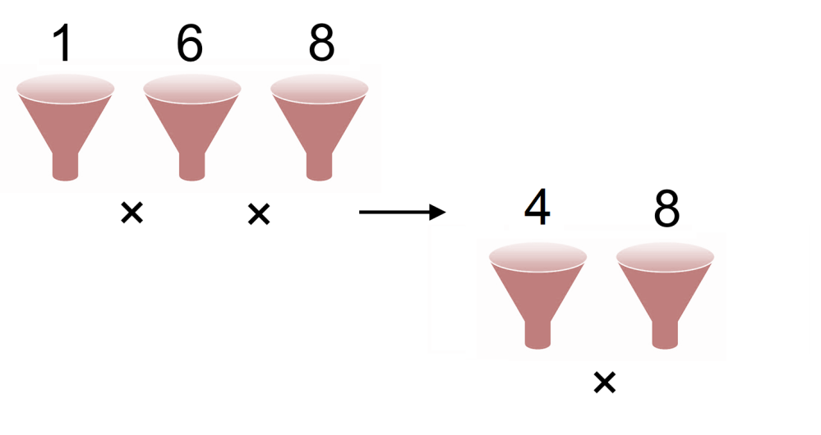
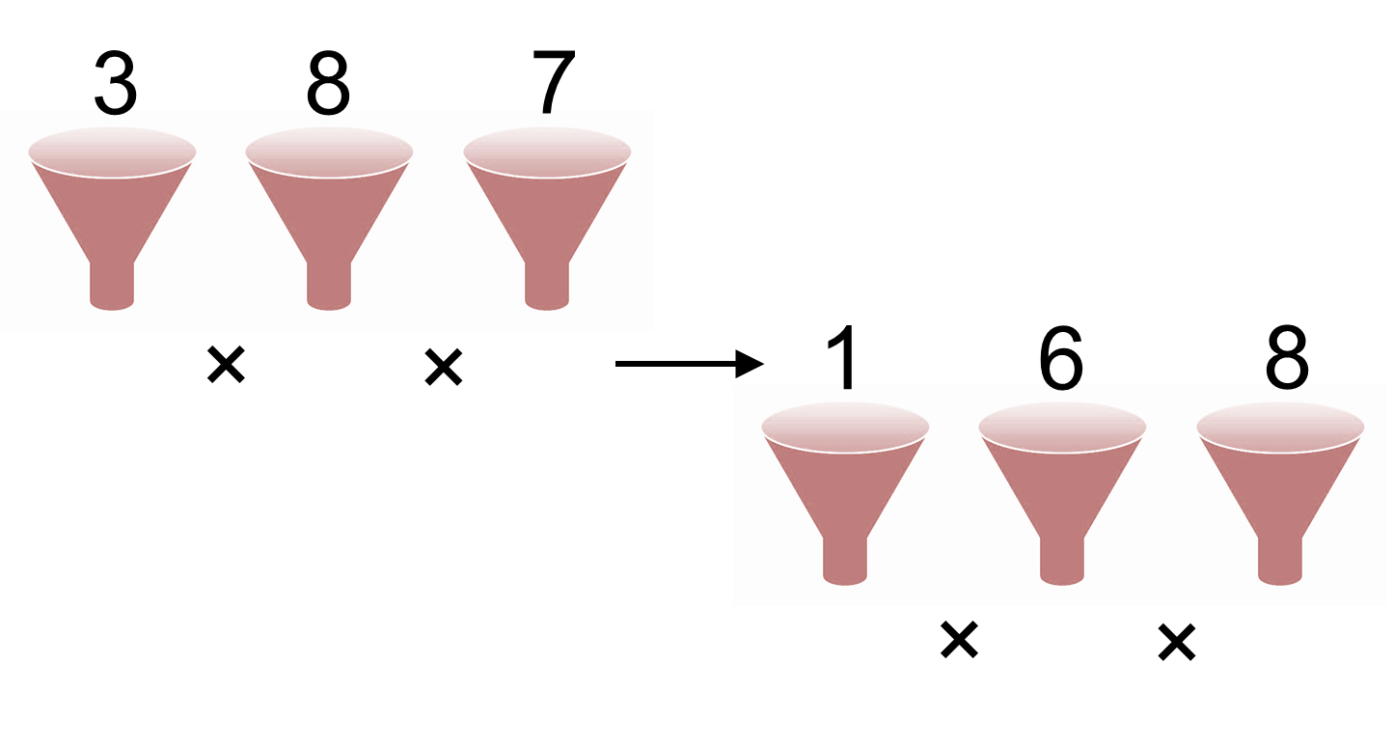
Multiplication Reduction: Instructions
Choose any 3 digit number
Multiply the digits together to get a new number
Multiply the digits of the new number together
Keep doing this until you are left with a single number
This is your “root”

Slide 3
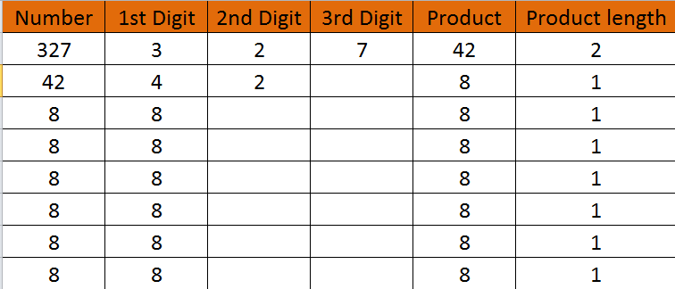
Multiplication Reduction Checker…

