Slide 1
Maths Rich Task Number Reverse

Slide 2
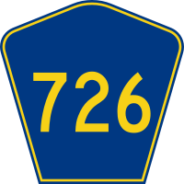
Number Reverse: Instructions
The number 726 can be formed by adding a 3-digit number with its reversal:
462 + 264 = 726
Can you find the two other ways to do this?

Slide 3
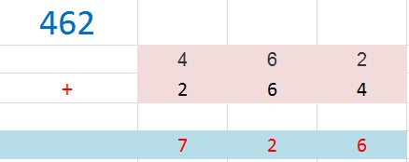
Number Reverse Checker…

