Slide 1
Maths Rich Task 9: Simultaneous Equations Staircase

Slide 2
Simultaneous Equations: Instructions
Choose any two linear sequences and write down any 3 consecutive terms
7, 11, 15 and 10, 17, 24
Write them out in order as simultaneous equations
e.g. 7x + 11y = 15
10x + 17y = 24
Now solve them
Try again with two different linear sequences

Slide 3
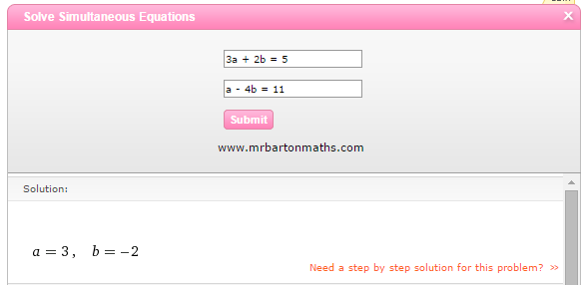
Online widget to solve simultaneous equations

