Slide 1
Edexcel Pearsons A Level Art and Design in Fine Art or Photography
2 Year Linear Course
2021 - 2022

Slide 2
Introduction
﻿Art and Design requires engagement with aesthetic and intellectual concepts through the use of traditional and/or digital media, materials, techniques and processes for the purpose of self-expression, free of external constraints.
Art and Design may be created to communicate ideas and messages about the observed world, the qualities of materials, perceptions, or preconceptions. It can also be used to explore personal and cultural identity, society and how we live, visual language, and technology.
Art and Design allows us to consider and reflect on our place in the world, both as individuals and collectively.

Slide 3
Component 1 60%
Personal Investigation Portfolio and Personal Study (continuous rose with integrated images)

Slide 4
Component 2 40%
Externally set exam
15 hour exam to conclude a final image

Slide 5
Assessment Objectives
AO1 - Develop ideas through sustained and focused investigations informed by contextual and other sources, demonstrating analytical and critical understanding. 25%
AO2 - Explore and select appropriate resources, media, materials, techniques and processes, reviewing and refining ideas as work develops. 25%
AO3 - Record ideas, observations and insights relevant to intentions, reflecting critically on work and progress . 25%
AO4 - Present a personal and meaningful response that realises intentions and, where appropriate, makes connections between visual and other elements. 25%

Slide 6
Themes
Disorder & Chaos
Exploitation
Female Form
Opposites
Fantasy & Fiction
Black & White
Architecture
Abuse
Anxiety
Anxiety
Mental Health
Retrospective
Reflections
Colour & Tone
Flora & Fauna
Pattern
Surrealism
Identity
Culture
Illustration
Societies
Food
This World
The Body
Under the Sea
Machines
Connections

Slide 7
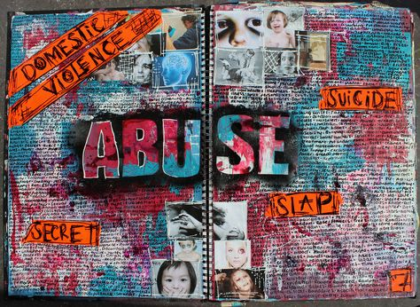
Title Page

Slide 8
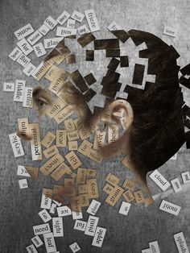

Slide 9
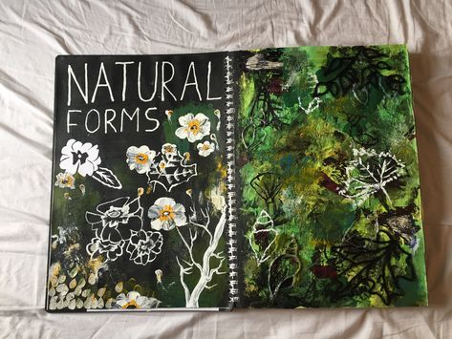

Slide 10
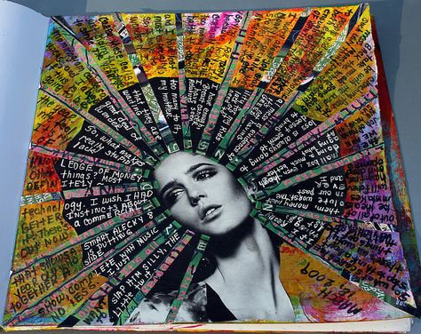
Mind Map Ideas

Slide 11
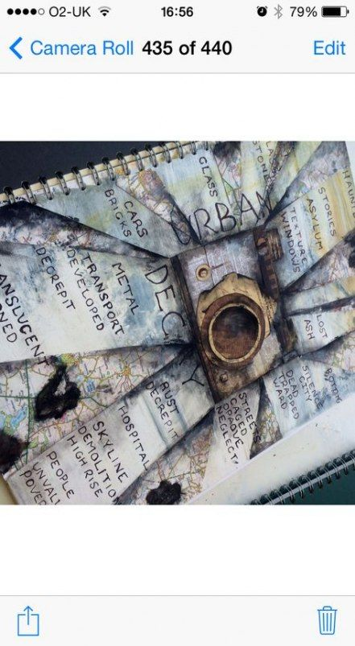

Slide 12
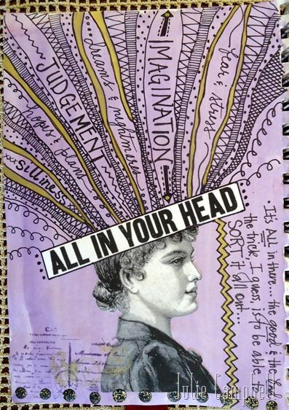

Slide 13
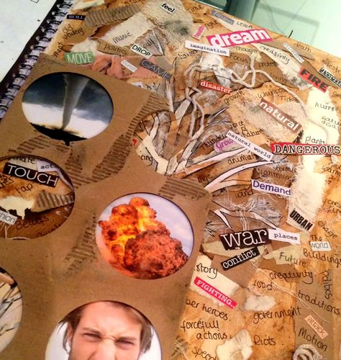

Slide 14
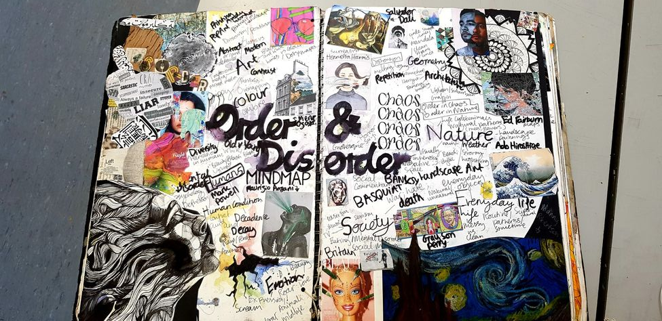

Slide 15
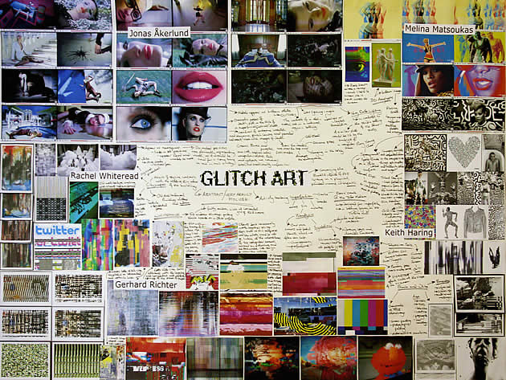

Slide 16
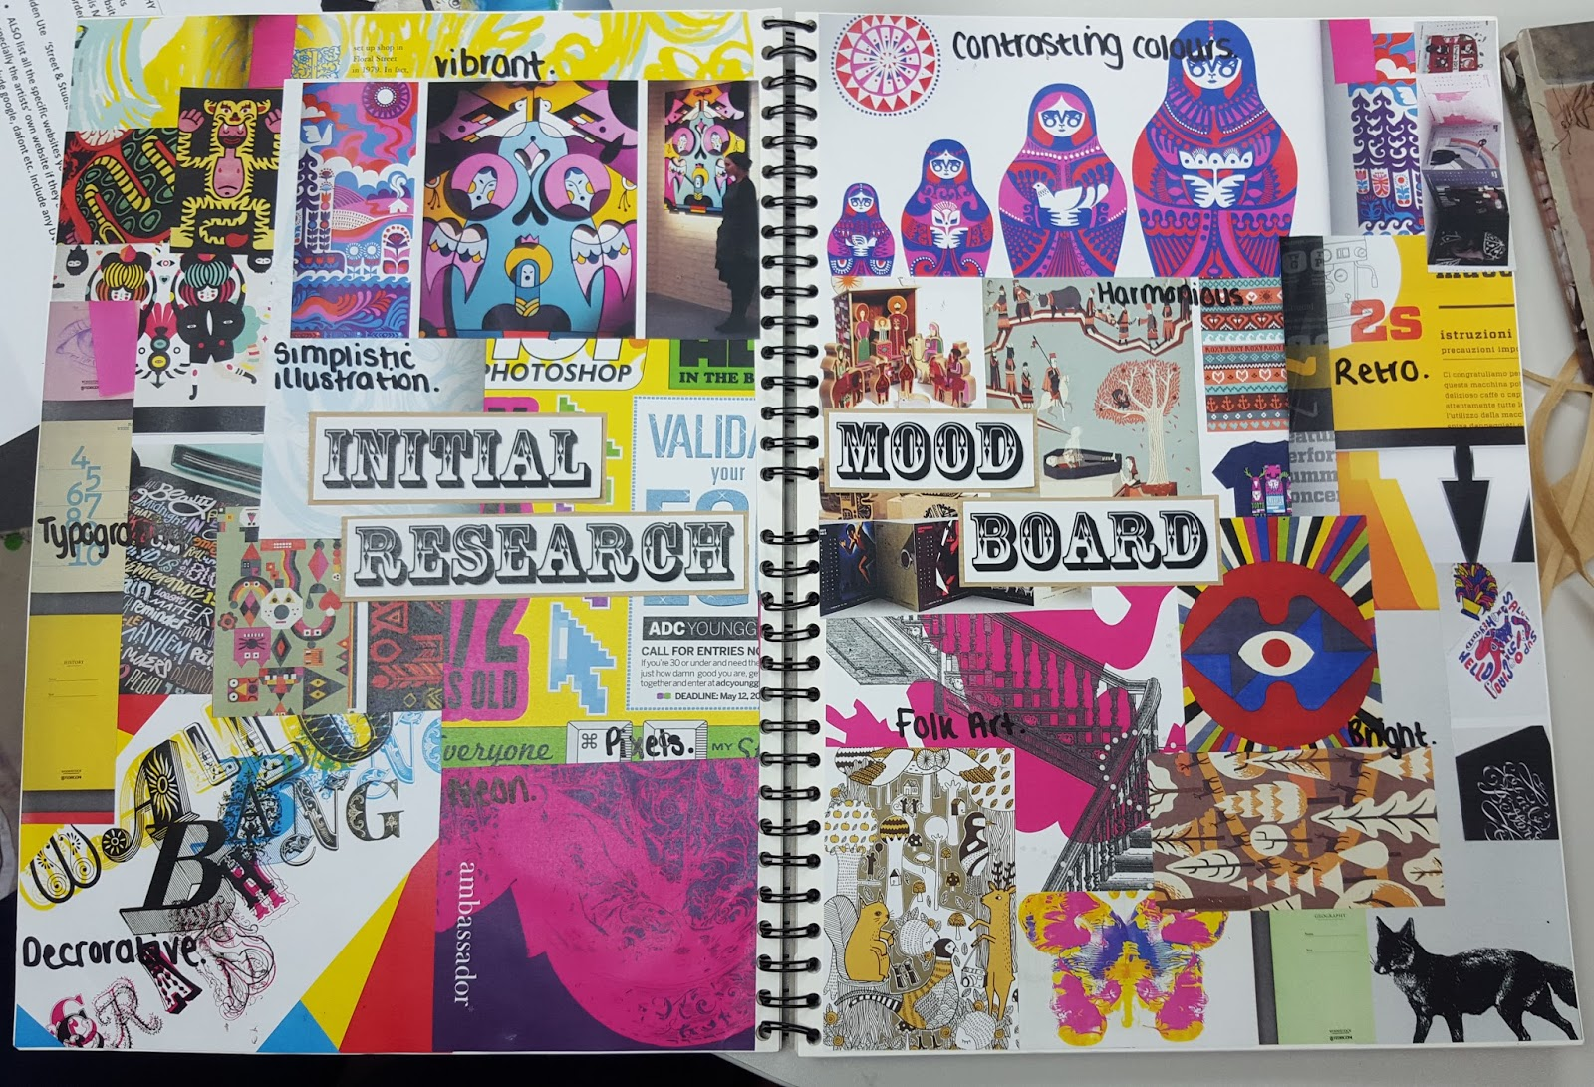

Slide 17
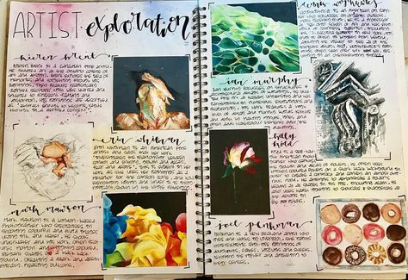
Artist Exploration

Slide 18
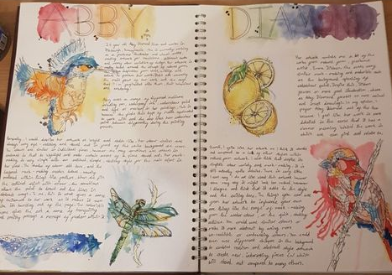

Slide 19
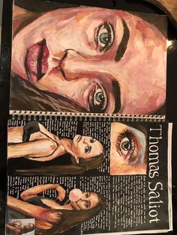

Slide 20
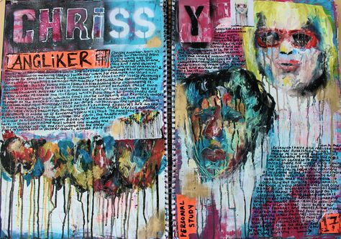

Slide 22
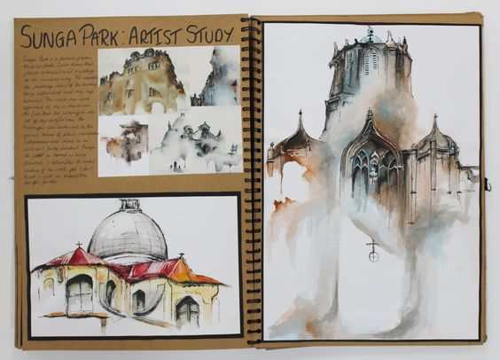

Slide 23
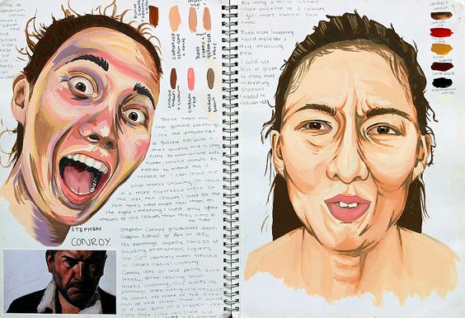
Developing ideas from primary sources

Slide 24
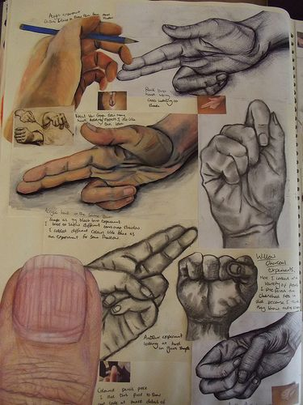
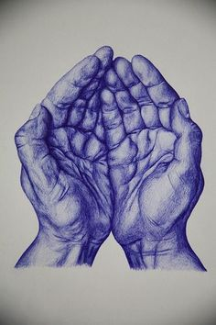

Slide 25
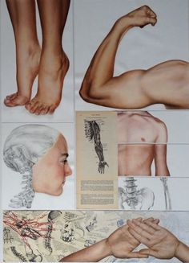
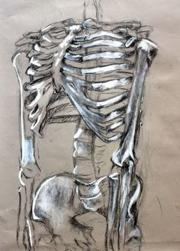

Slide 26
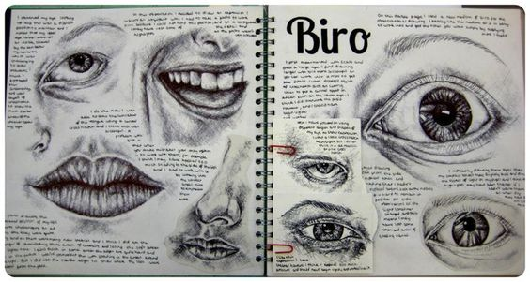

Slide 27
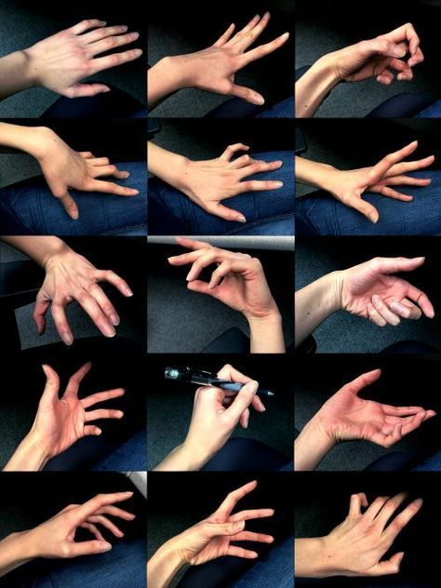

Slide 28
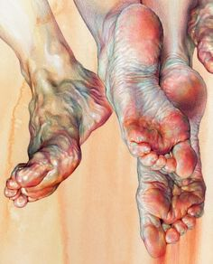
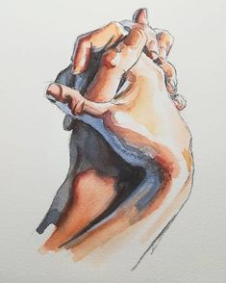

Slide 29
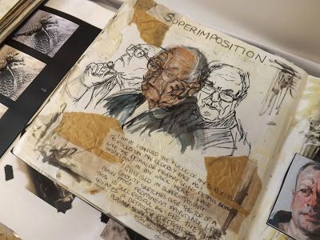
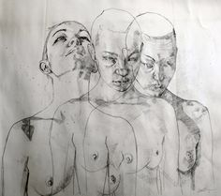
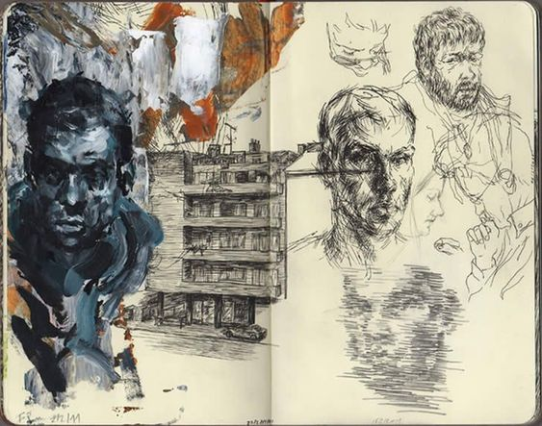
Developing composition

Slide 30
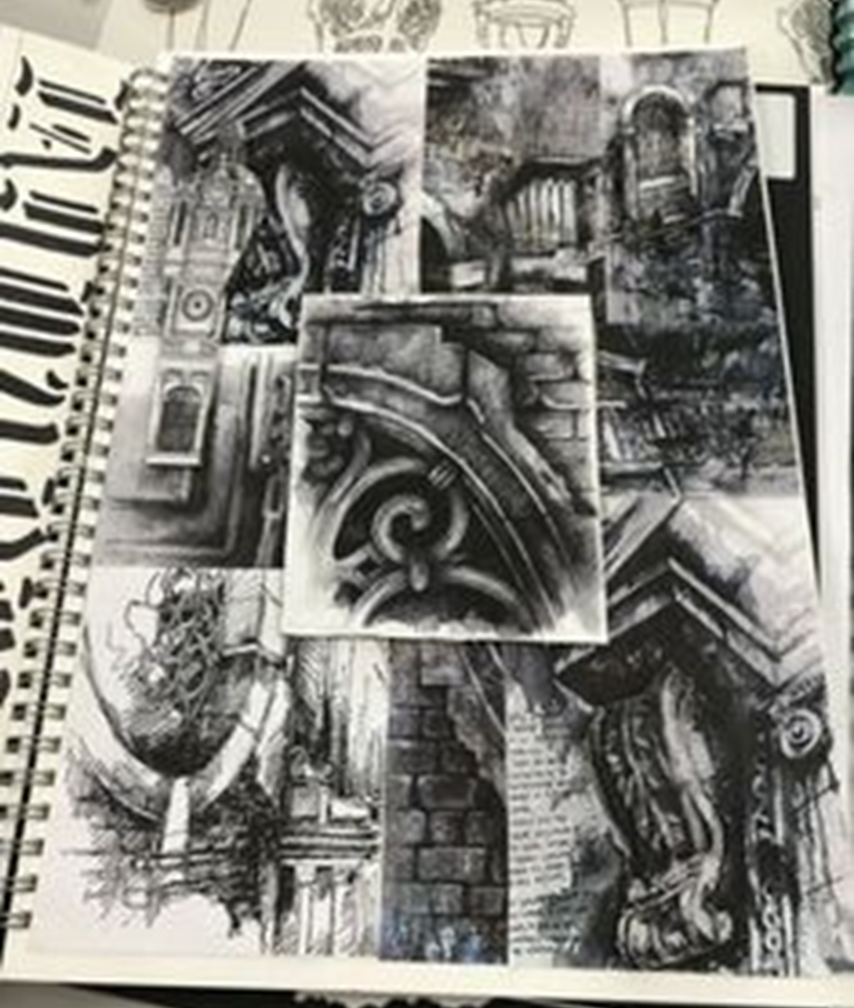
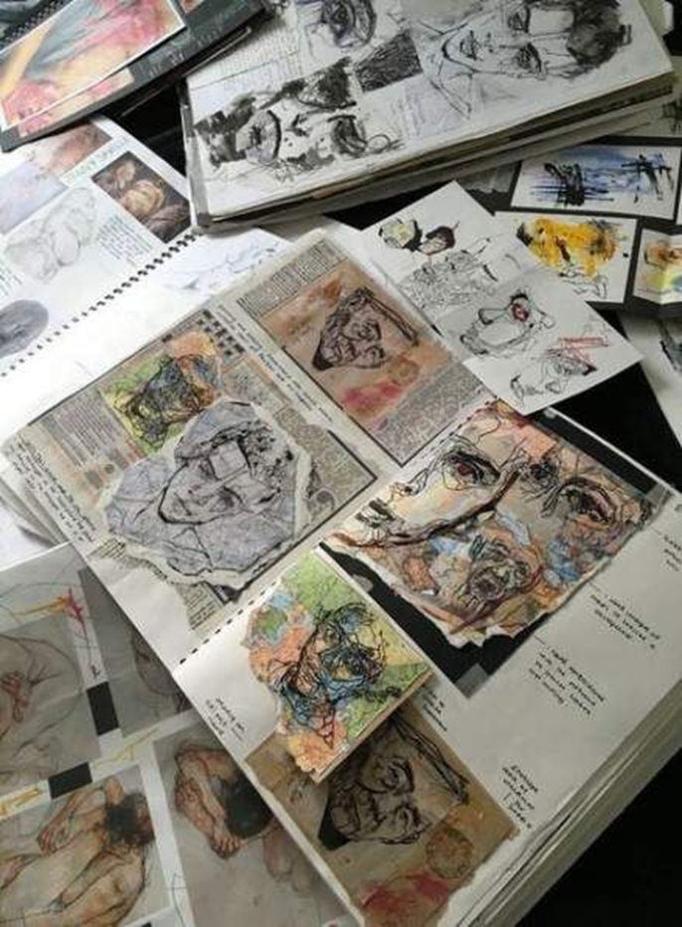

Slide 31
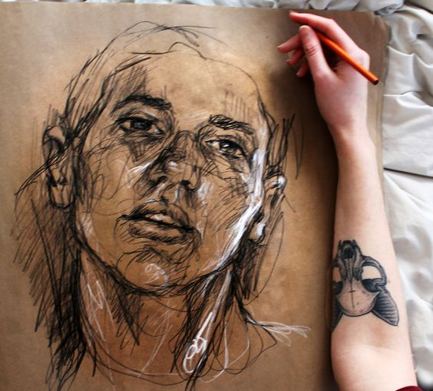
Chalk/charcoal on parcel paper

Slide 32
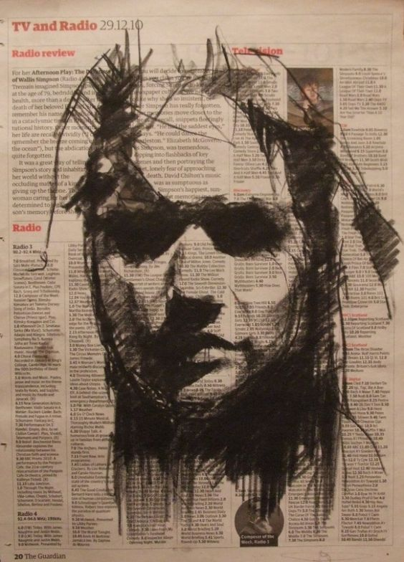
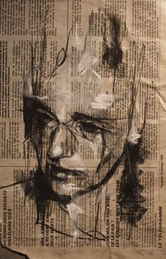
Charcoal and text paper

Slide 33
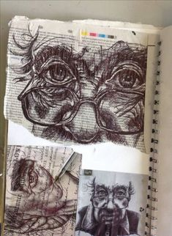
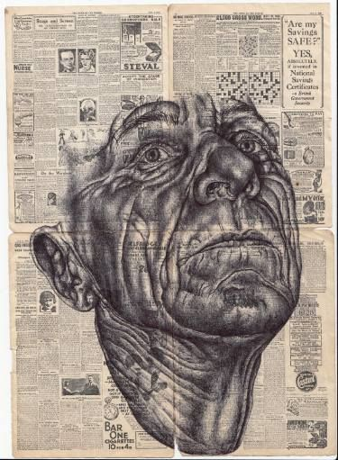
Ink

Slide 34
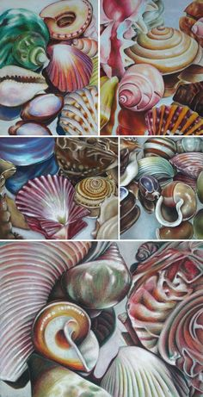
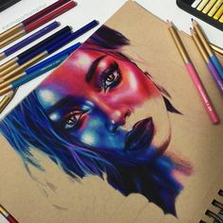
Colour Pencil

Slide 35
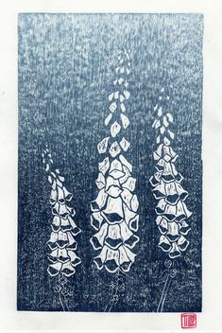
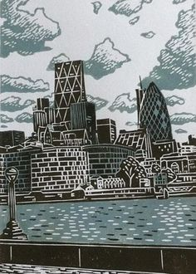
Lino

Slide 36
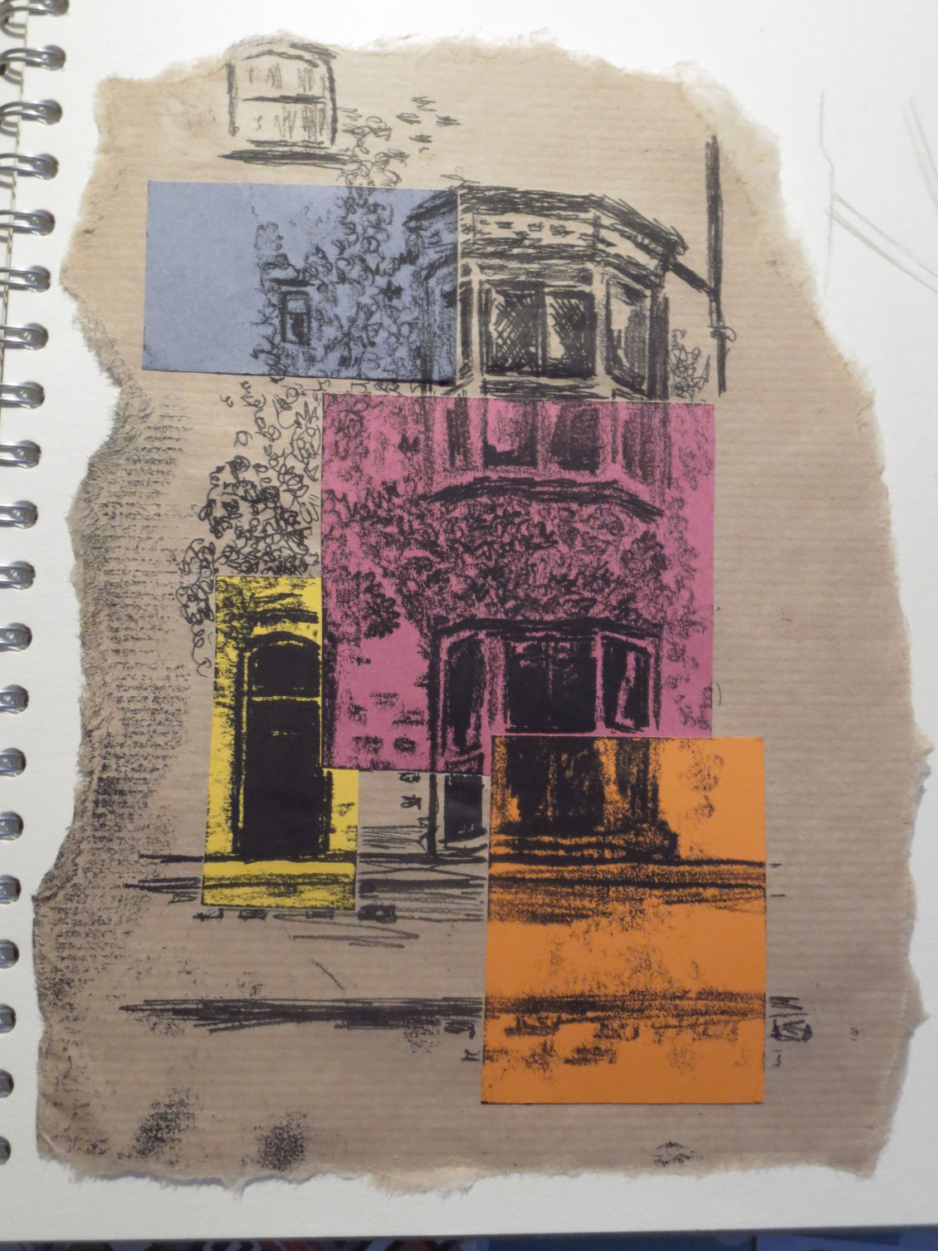
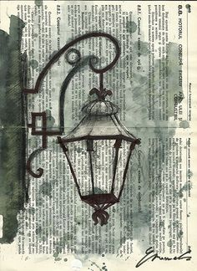
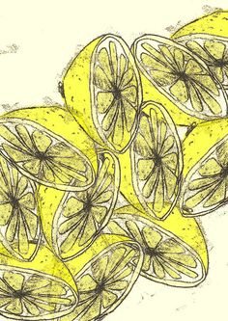
Mono printing

Slide 37
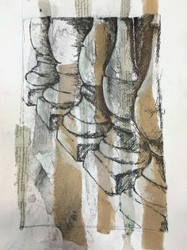
Mixed Media

Slide 38
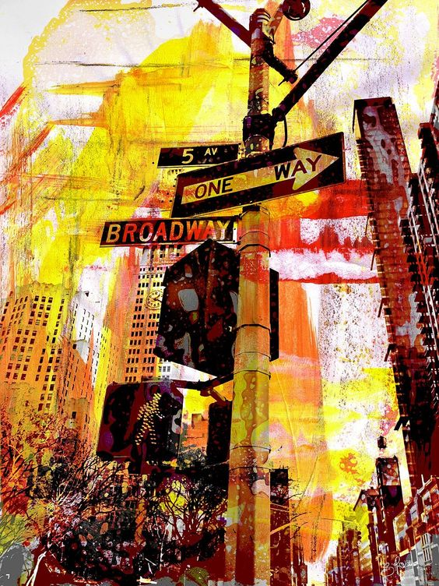

Slide 39
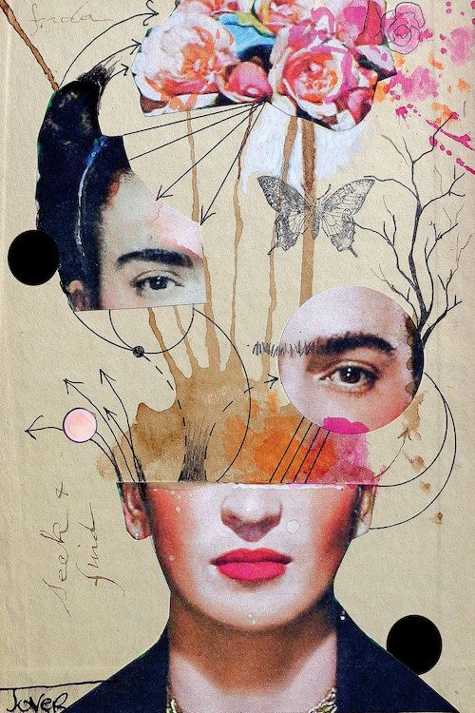
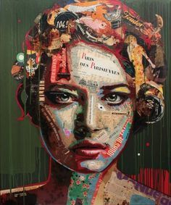
Collage

Slide 40
Photographs

Slide 41
Recording Observations

Slide 42
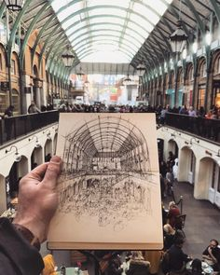

Slide 43
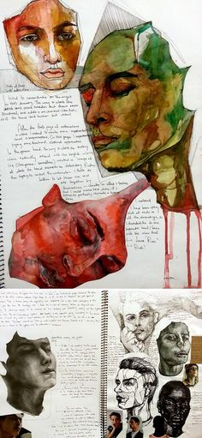
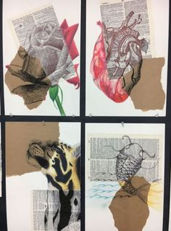

Slide 44
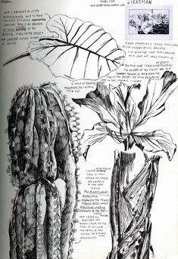
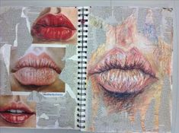

Slide 46
Developing ideas into larger finished pieces / refined

