Slide 1
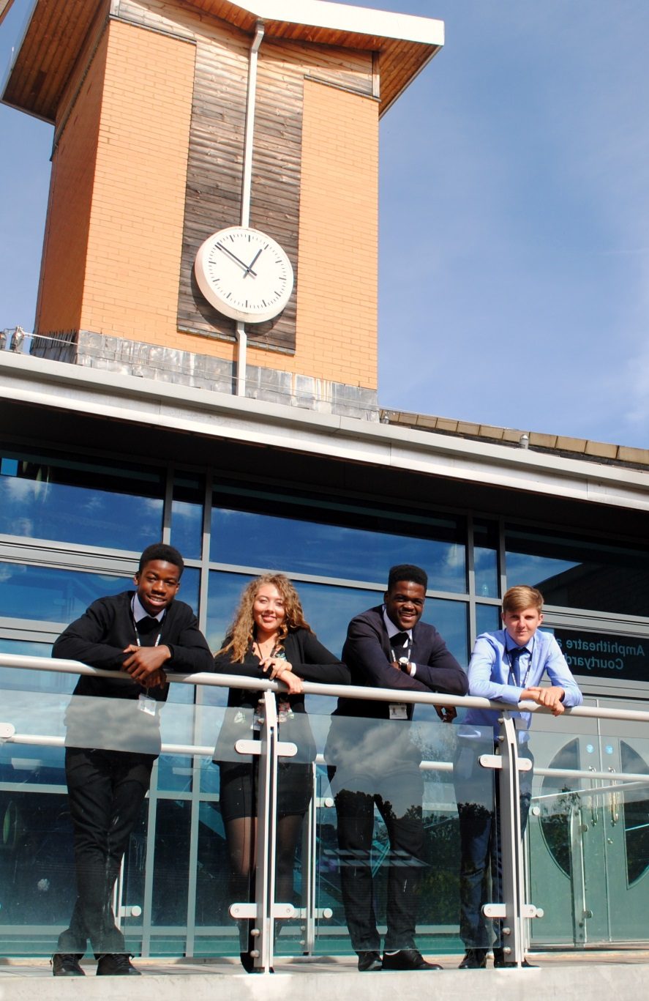
Sixth Form Subject Taster BTEC National Diploma in Business Pearson BTEC 601/7157/1
St Mary’s Sixth Form & Leadership Centre
Aspire – Challenge – Succeed
We believe everyone is equal, everyone deserves the best

Slide 2
Course Breakdown
STUDENTS WILL STUDY:
Unit 1: Exploring Business
Unit 2: Developing a Marketing Campaign
Unit 5: International Business
Unit 17: Digital Marketing
Unit 3: Personal & Business Finance
Unit 8: Recruitment and Selection
Unit 4: Managing an Event
Unit 6: Principles of Management

Slide 3
Course Breakdown:
Unit 1: Exploring Business
In this introductory unit, you will study the purposes of different businesses, their structure, the effect of the external environment, and how they need to be dynamic and innovative to survive.
6 learning aims
3 Assignments

Slide 4
Course Breakdown:
Unit 2: Developing a Marketing Campaign
You will gain skills relating to, and an understanding of, how a marketing campaign is developed. Practical research skills will be developed along with creative marketing for the campaign.
3 learning aims
3 hour controlled assessment (70 marks) first sitting January

Slide 5
Course Breakdown:
Unit 3: Personal & Business Finance
You will study the purpose and importance of personal and business finance. You will also develop the skills and knowledge needed to understand, analyse and prepare financial information.
7 learning aims
2 hour exam (80/100 marks) first sitting January
Notes:
All students joining the sixth form are entitled to a number of items that will support their learning.

Slide 6
Course Breakdown:
Unit 4: Managing an Event
You will work as part of a small group to plan, coordinate and manage a business or social enterprise event and evaluate the skills gained. This unit combines your creativity and organisational skills to produce successful, memorable events, whether for profit or social enterprise.
5 learning aims
3 Assignments
Notes:
All students joining the sixth form are entitled to a number of items that will support their learning.

Slide 7
Course Breakdown:
Unit 5: International Business
In this unit, you will study how UK businesses develop strategies to trade globally. You will also consider the factors that influence the implementation of these strategies.
5 learning aims
3 Assignments

Slide 8
Course Breakdown:
Unit 6: Principle of management
This unit enables learners to understand how the role of management and leadership in the workplace contributes towards business success. You will examine how businesses adapt their approaches to management in response to challenges in their environment
6 learning aims
3 hour controlled assessment in January (year 13)

Slide 9
Course Breakdown:
Unit 8: Recruitment and Selection
You will explore how the recruitment process is carried out in a business. The unit gives you the opportunity to participate in selection interviews and review your performance.
3 learning aims
2 Assignments

Slide 10
Course Breakdown:
Unit 17: Digital Marketing
You will examine the different aspects of web-based marketing, and the channels that can be used to deliver a successful digital marketing campaign. In this unit you will develop your marketing skills and provide an understanding of the role of digital marketing in identifying and satisfying customers
3 learning aims
2 Assignments

Slide 11
Mode of Study
Year 1 you will start working on four units towards completing your first assignment as well as learning content and technique for your first exam which will be in January. The remaining assignments will be completed after the exam.
Lessons will include:
Subject specific areas being taught
Discussions surrounding real business situations
Research tasks and data gathering
Trip to see a major brand working

Slide 12
Independent Study
Independent study is key to your success in this qualification
Extended learning tasks will be set to support assignment preparations
Your assignment completions will require significant independent research and work completion in order to meet the submission deadlines
All deadlines must be met

Slide 13
Equipment
You will require a computer/laptop with internet access for research and assignment completion
You will need to follow the Business news to keep up to date
Pearson BTEC National Business Student Book 1 covers all these units ISBN: 9781292126241
You should review the BTEC Extended Certificate Specification: https://qualifications.pearson.com/content/dam/pdf/BTEC-Nationals/Business/2016/specification-and-sample-assessments/BTECNationals_Bus_ExCert_Spec.pdf

Slide 14
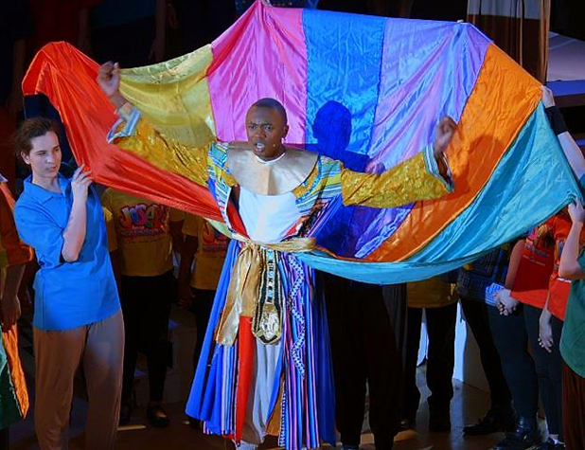
Cross Curricular Links
The Aspire Business & Enterprise Academy work closely with your business qualification and provide enrichment activities such as Young Enterprise, work experience opportunities, portfolio of additional courses and training
Business interlinks with other subjects such as Economics, Law, Psychology, Geography, Maths, English, History and Design

Slide 15
Post 18 Links
University courses: HUGE range of degrees available including Business & Administration, Business Finance and Accounting, Business and HR, Business Management and Economics, Law, Marketing, International Business
Apprenticeships: MANY opportunities such as Accounting and Business advisory, Business Management, Marketing, Finance, HR, Project Management, Technology
Training programmes: Health & Safety, Business Management, Accounting, Law, HR

Slide 16
Transition Tasks
In order to prepare for year 12, research and write a brief report explaining the following:
> What is marketing? > Define the 4ps of the marketing mix. > What is digital marketing? > How does digital marketing differ from traditional marketing?
After carrying out your research what are your thoughts on the following question: ‘Which is more important now and in the future, traditional or digital marketing?’ Explain your thoughts using your research.

Slide 17
Follow us on @SMHSixth
ASPIRE - CHALLENGE - SUCCEED

