Slide 1
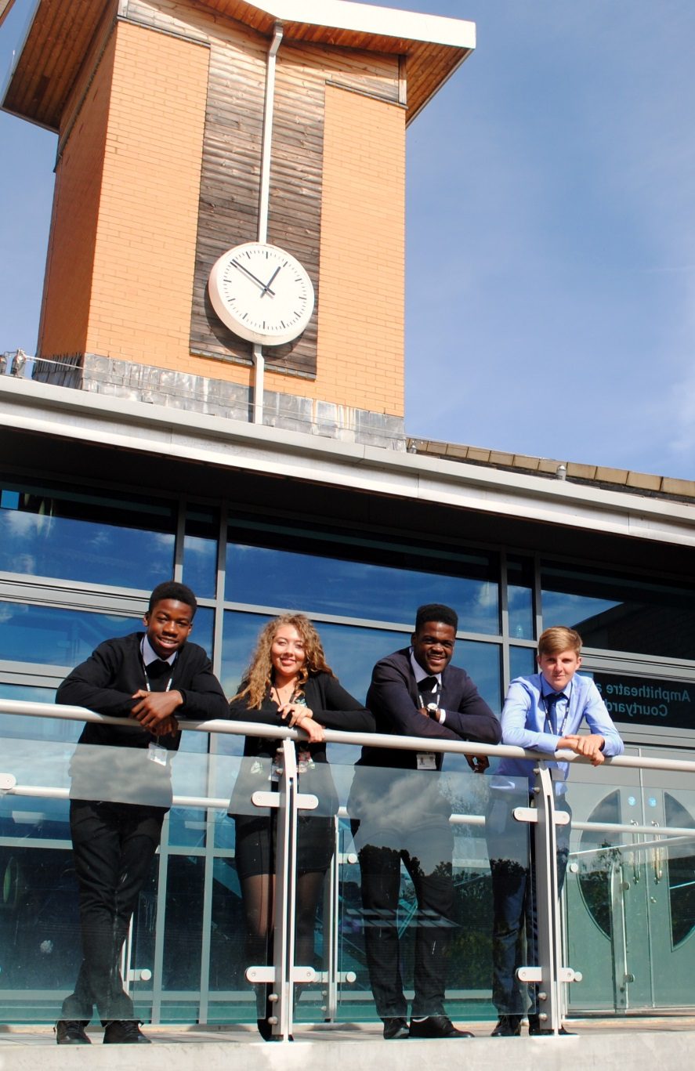
Sixth Form Subject Taster BTEC National Diploma in Information Technology Pearson Edexcel BTEC 603/0455/8
St Mary’s Sixth Form & Leadership Centre
Aspire – Challenge – Succeed
We believe everyone is equal, everyone deserves the best

Slide 2
Course Breakdown
The BTEC National Diploma in IT is a double qualification which equates to 2 A-Levels
STUDENTS WILL STUDY:
Unit 1: Information Technology Systems
Unit 2: Creating Systems to Manage Information
Unit 3: Social Media in Business
Unit 6: Website Development
Unit 8: Computer Games Development
Unit 11: Cyber Security & Incident Management
Unit 9: IT Project Management
Unit 4: Programming

Slide 3
Course Breakdown Component 1
Unit 2: Creating Systems to Manage Information
In this exam unit you will study the design, creation, testing and evaluation of a relational database system to manage information
4 learning aims
5 hour exam (3 hours for part A and 2 hours for part B)

Slide 4
Course Breakdown: Component 2
Unit 3: Social Media in Business
In this unit of work you will explore how businesses use social media to promote their products and services. You will also learn how to implement social media activities in a business to meet requirements.
3 learning aims
2 assignments
Notes:
All students joining the sixth form are entitled to a number of items that will support their learning.

Slide 5
Course Breakdown: Component 3
Unit 8: Computer Games Development
In this unit of work you will investigate the computer games industry and its impact on technological and social trends. You will also design and develop a computer game to meet set requirements.
3 learning aims
2 assignments

Slide 6
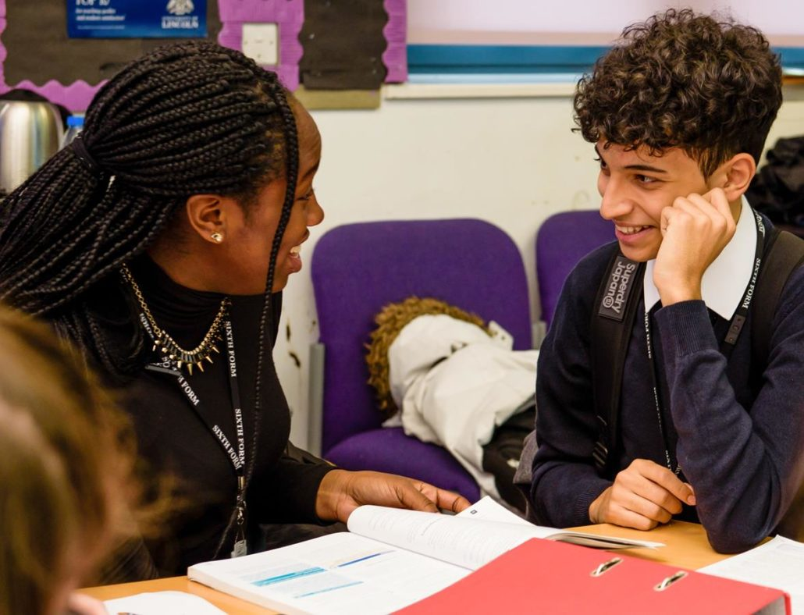
Course Breakdown: Component 4
Unit 11: Cyber Security and Incident Management
In this exam unit you will study Cyber security threats and vulnerabilities, the methods that are used to protect systems against threats and how to plan and manage security incidents.
5 learning aims
9 Hour exam over 2 days (5 hours part A & 4 hours part B)

Slide 7
Course Breakdown: Component 3
Unit 1: Information Technology Systems
In this exam unit you will study the role of computer systems and the implications of their use in personal and professional situations.
6 learning aims
2 hour exam sat in year 13

Slide 8
Course Breakdown: Component 4
Unit 6: Website Development
In this unit of work you will investigate website development principles. You will also design and develop a website using scripting languages.
3 learning aims
2 assignments

Slide 9
Course Breakdown: Component 7
Unit 9: IT Project Management
In this unit of work you will investigate a range of project management principles and methodologies and undertake a management of an IT project from start to finish.
4 learning aims
3 assignments

Slide 10
Course Breakdown: Component 8
Unit 4: Programming
In this unit of work you will study the underpinning concepts and implications of programming languages to design, develop and test computer programs.
3 learning aims
2 assignments

Slide 11
Mode of Study
Year 1 you will start working on four units towards completing your first assignments as well as learning content and technique for your first two exams which will be in April/May. You will be taught exam content and practice for unit 2 as well as unit 11. This is taught alongside unit 3 & 8 which are completed throughout year 12
Lessons will include:
Subject specific areas being taught
Discussions surrounding IT scenarios
Research tasks and data gathering

Slide 12
Independent Study
Independent study is key to your success in this qualification
Extended learning tasks will be set to support assignment preparations
Your assignment completions will require significant independent research and work completion in order to meet the submission deadlines
All deadlines must be met

Slide 13
Equipment
You will require a computer/laptop with internet access for research and assignment completion
Pearson REVISE BTEC National Information Technology Revision Guide 3rd edition, this can be found on Amazon using this link: https://www.amazon.co.uk/Revise-National-Information-Technology-Revision/dp/1292299096/ref=sr_1_11?dchild=1&keywords=btec+level+3+IT&qid=1625494881&sr=8-11
You should review the BTEC Diploma Specification: https://qualifications.pearson.com/content/dam/pdf/BTEC-Nationals/Information-Technology/2016/specification-and-sample-assessments/specification-pearson-btec-level-3-national-diploma-in-information-technology.pdf
It is also important that you start to learn/practice your programming skills within Python in preparation for unit 4

Slide 14
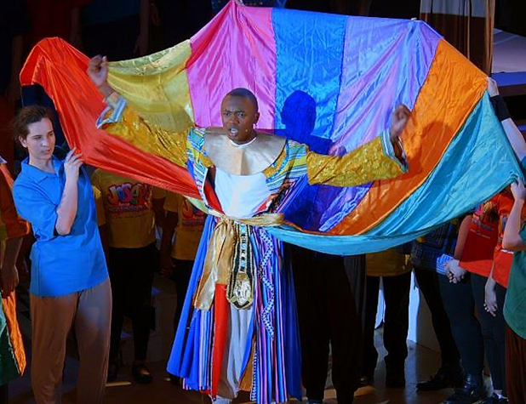
Cross Curricular Links
The Aspire Business & Enterprise Academy works closely with your IT qualification and provides enrichment activities such as Young Enterprise, work experience opportunities, portfolio of additional courses and training
IT interlinks with other subjects such as Law, Psychology, Maths, English, History and Design

Slide 15
Post 18 Links
There are a huge range of different degrees that are available including: Cyber security, Computer games development, Software development, Computer Networking etc.
There are also apprenticeships including: IT support, IT technician etc.

Slide 16
Transition Tasks
The transition work that has been uploaded helps you prepare for your first 2 coursework units, Unit 3 Social Media in Business & Unit 8 Computer Games Development. For Unit 3 you will need to carry out research on how companies can use social media to help them communicate or promote products to customers. For unit 8 you will need to research the Computer Games industry and how technology, current and emerging, can impact on the design and development of games.

Slide 17
Follow us on @SMHSixth
ASPIRE - CHALLENGE - SUCCEED

