Slide 1
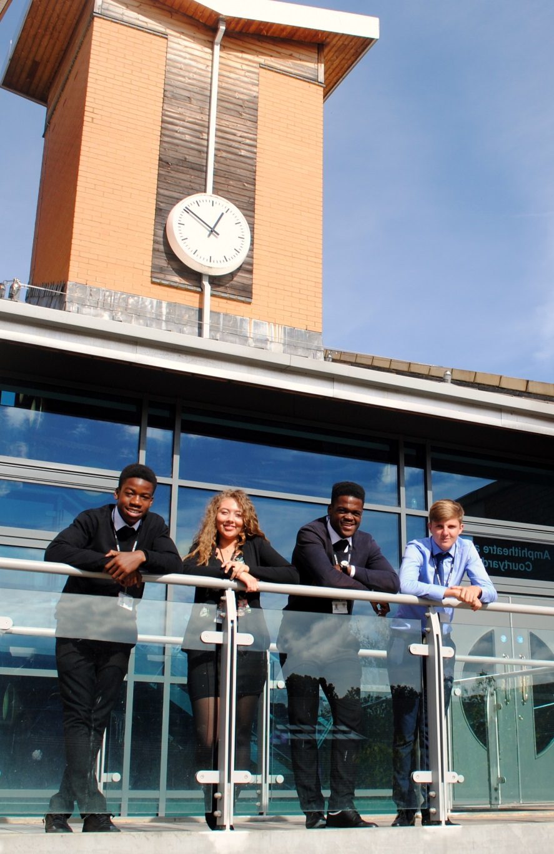
Sixth Form Subject Taster A Level ENGLISH LITERATURE OCR H472
St Mary’s Sixth Form & Leadership Centre
Aspire – Challenge - Succeed

Slide 2
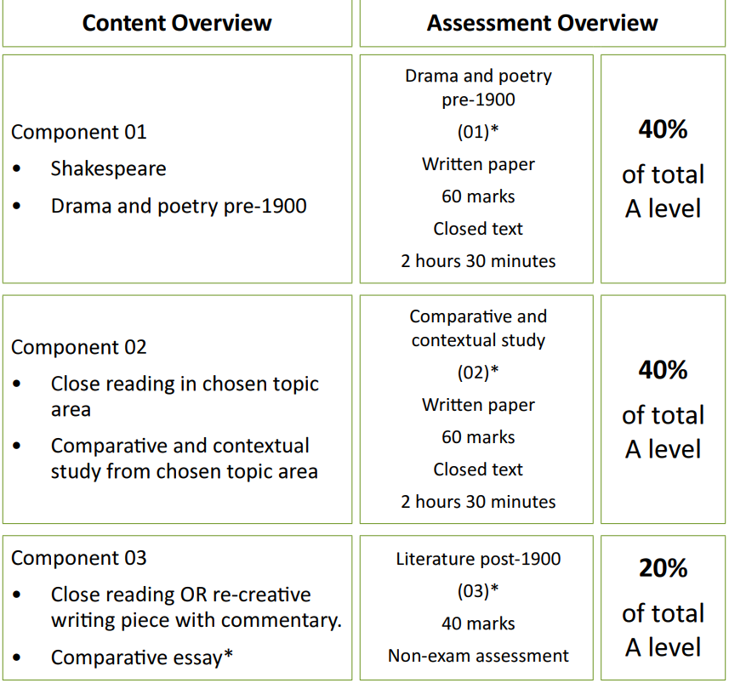
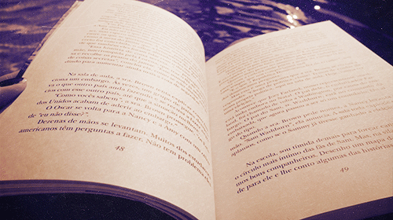
Course Breakdown https://www.ocr.org.uk/qualifications/as-and-a-level/english-literature-h072-h472-from-2015/

Slide 3
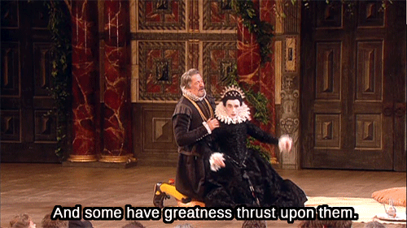
Course Breakdown: Component 1
Our chosen text is Twelfth Night

Slide 4
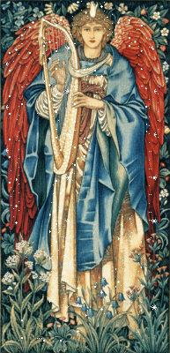
Course Breakdown: Component 1
Our chosen texts are Henrik Ibsen’s A Doll’s House
&
Christina Rossetti’s
Selected Poems
.

Slide 5
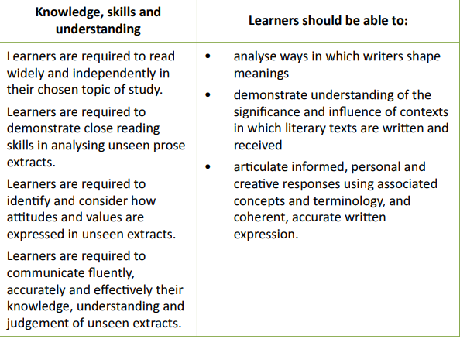
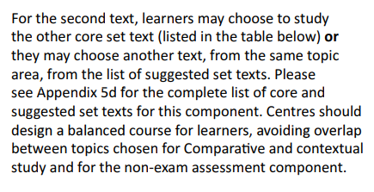
Course Breakdown Component 2
Our chosen topic is
The Gothic

Slide 6
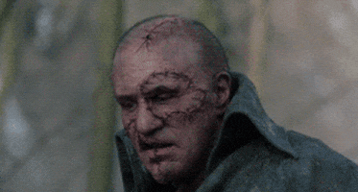
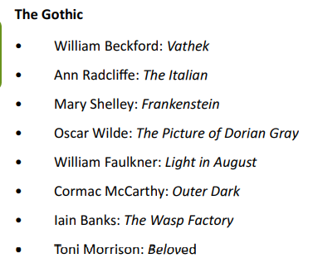
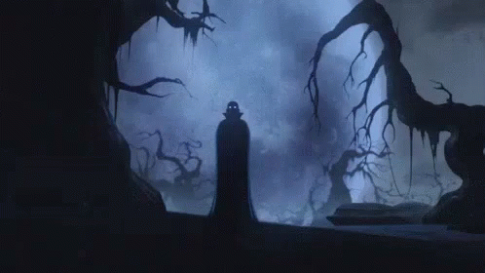

Slide 7
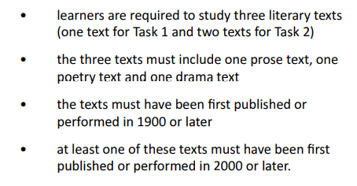
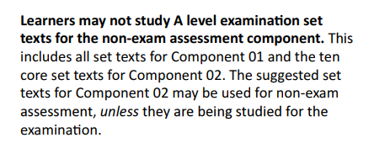
Course Breakdown: Component 3- NEA Literature post-1900
Notes:
All students joining the sixth form are entitled to a number of items that will support their learning.

Slide 8
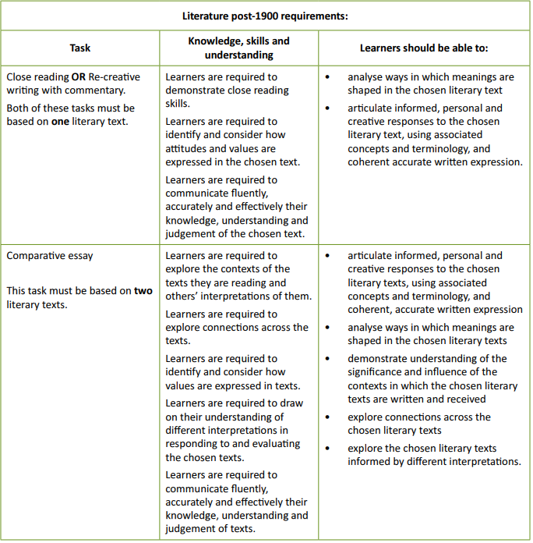
NEA REQUIREMENTS

Slide 9
Mode of Study
You will have a mixture of ways of learning.
Some will be directed research, some will be independent writing but a majority of it will be class-based, teacher lead learning. You will watch a variety of productions of Twelfth Night and tune in to some on-line lectures.
There will be lots of opportunity to develop your essay writing skills and an important part of developing these skills is to scrutinise exemplar responses and mark schemes.
Wider reading is essential in order to develop an understanding of conventions and context. Critical theory will be a vital part of understanding texts at a deeper level.

Slide 10
Independent Study
The hours spent in the classroom will not be enough to hit the grades that you will aspire to.
You will need to support your NEA with reading, researching and writing outside of the teaching hours.
You will need to read a wide range of literary criticism .
You will have mini independent projects to develop your presentation skills.

Slide 11
Resources and reading
Your key texts will be provided for you but the
wider reading texts are available from the LRC.
You will need to engage with the English Department Website. https://smhsenglishdept.weebly.com/ks5-literature.html
You will be expected to read articles and blogs. There are a range of relevant essays and blogs on The British Library website. https://www.bl.uk/
The Times Literary Supplement has articles that will develop your literary knowledge.
https://www.the-tls.co.uk/

Slide 12
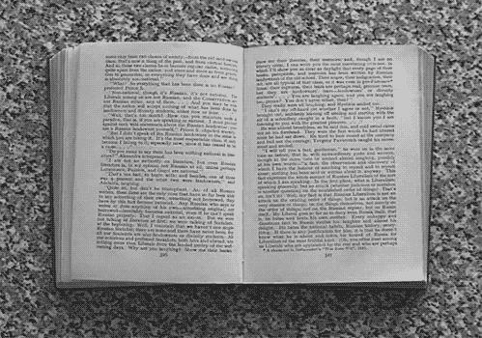
Cross Curricular Links
English Literature refer to elements of:
Sociology- Gender issues, society and the way it treats certain genders or social groups.
History- How history has impacted on literature over time. How roles and expectations have developed. The impact of historical events such as war, the French revolution, the swinging sixties, the industrial revolution on creativity.
Psychology- Mental health issues, toxic relationships, representations of mental health. Psychoanalytical readings/ Freudian readings of texts.
English Language- how language develops over time.
Religious Studies- How biblical imagery/ intertextuality is seen in Victorian texts.

Slide 13
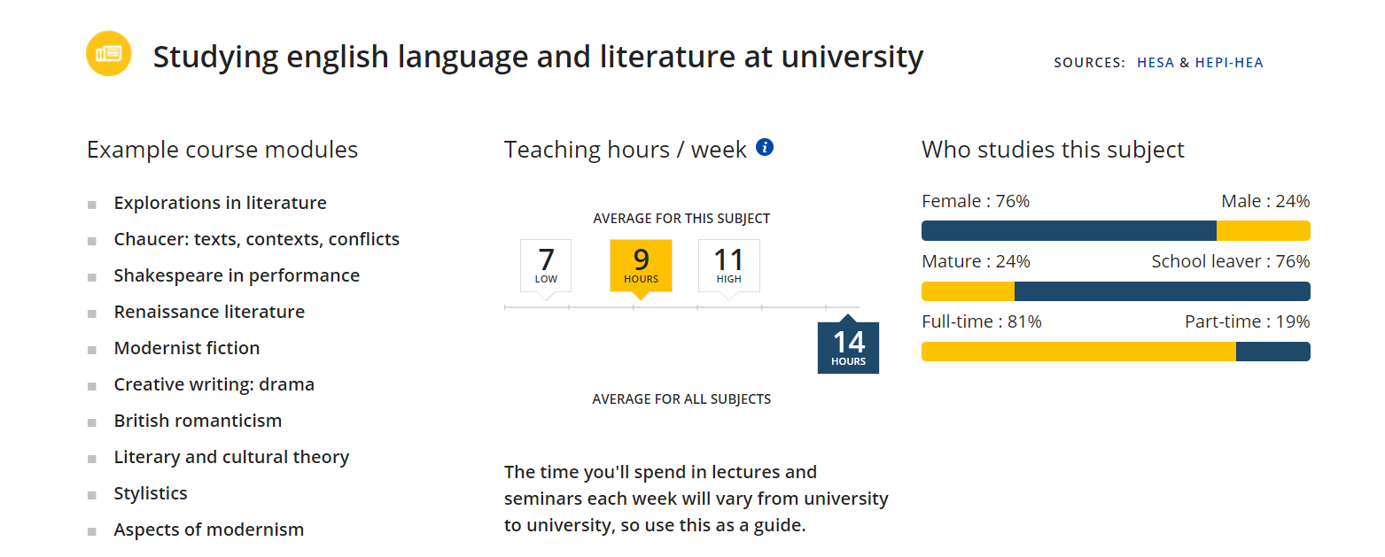
Post 18 Links

Slide 14
Transition Tasks- the EMC booklet of tasks

Slide 15
Follow us on @SMHSixth
And
https://smhsenglishdept.weebly.com/ks5-literature.html
ASPIRE - CHALLENGE - SUCCEED

