Slide 1
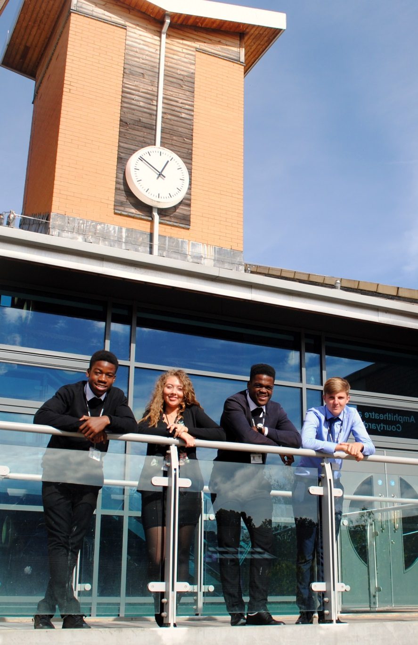
A Level Further Mathematics Edexcel 9FM0
St Mary’s Sixth Form & Leadership Centre
‘Everyone is equal, everyone deserves the best’

Slide 2
Subject Pre-requisites
Having an interest in mathematics is important for success
There are a wealth of excellent quality maths content creators on youtube such as:
3blue1brown
Standupmaths
Numberphile

Slide 3
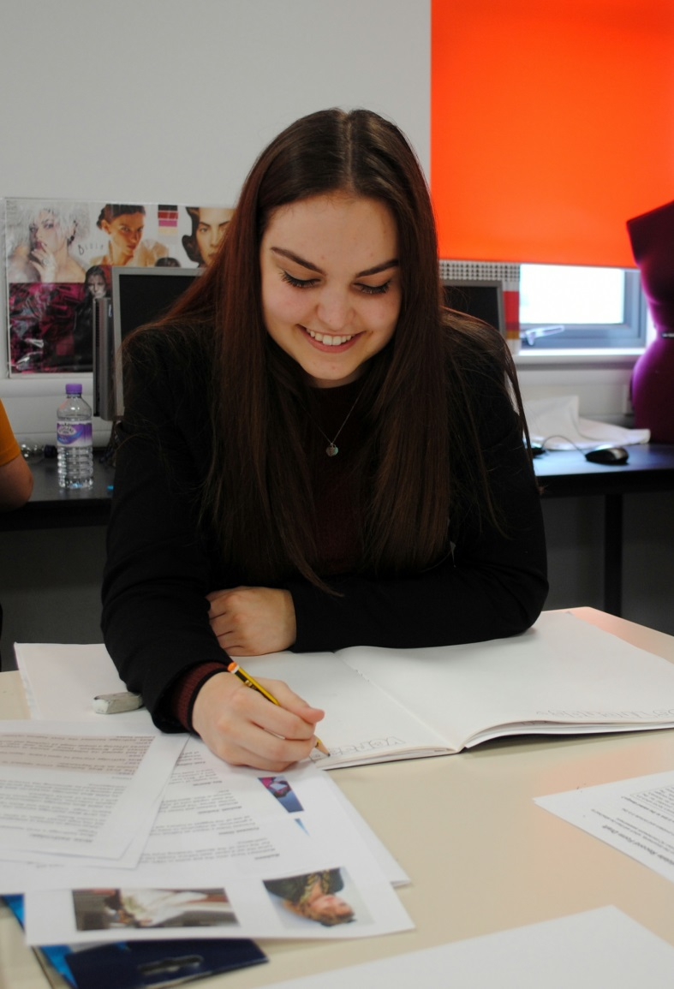
Course Breakdown
This Pearson Edexcel Level 3 Advanced GCE in Further Mathematics builds on the skills, knowledge and understanding set out in the whole GCSE subject content for mathematics and the subject content for the Pearson Edexcel Level 3 Advanced Subsidiary and Advanced GCE Mathematics qualifications. Assessments will be designed to reward students for demonstrating the ability to provide responses that draw together different areas of their knowledge, skills and understanding from across the full course of study for the AS further mathematics qualification and also from across the AS Mathematics qualification.
Problem solving, proof and mathematical modelling will be assessed in further mathematics in the context of the wider knowledge which students taking A level further mathematics will have studied. The Pearson Edexcel Level 3 Advanced GCE in Further Mathematics consists of four externally-examined papers.
Students must take Paper 1 and Paper 2, the two mandatory Core Pure papers, and two optional papers. Students are permitted to take more than the two optional papers if they want to extend their course of study. See page 56 for details of how their grade will be awarded. Students must complete all assessments in May/June in any single year.

Slide 4
Some Textbooks for the first year
Notes:
All students joining the sixth form are entitled to a number of items that will support their learning.

Slide 5
You will have a formula booklet

Slide 6
Mode of Study
A level maths will require large amounts of independent study
Lessons are at a faster pace
We do research and case studies
We encourage group studies alongside individual effort
We have drop-in sessions to support learning
You will be given weekly tasks
We pose challenges outside of the daily lessons
Students will have access to online resources from Hegarty and AMSP
Homework is set weekly
You are expected to work ahead

Slide 7
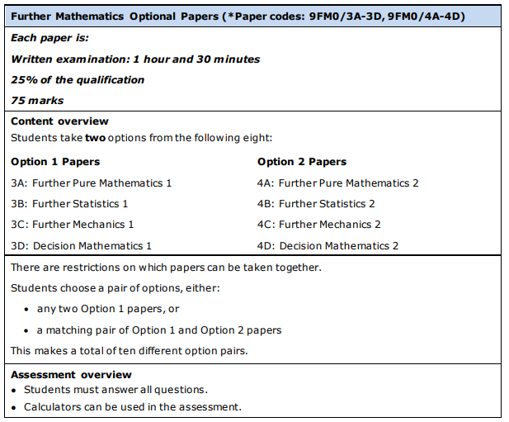
Mode of Assessment – Option modules

Slide 8
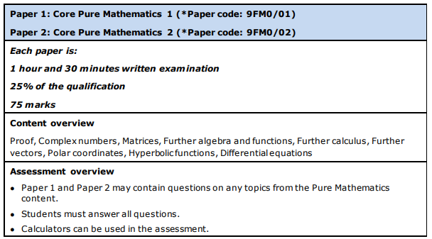
Mode of Assessment

Slide 9
Post 18 Links
With no bias or particular preference, this links shows some Mathematics related courses you could pursue at university
https://search.qmul.ac.uk/s/search.html?collection=queenmary-coursefinder-undergraduate-meta&query=mathematics

Slide 10
Follow us on @SMHSixth
‘Everyone is equal, everyone deserves the best’

