Slide 1
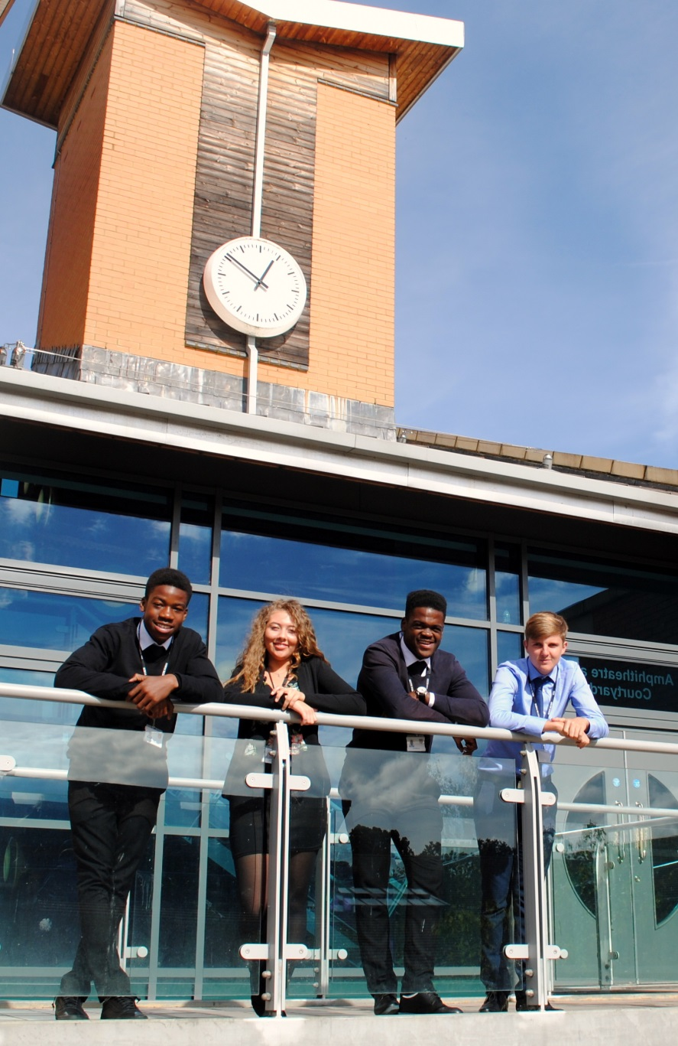

St Mary’s Sixth Form & Leadership Centre
Sixth Form Subject Taster
BTEC
Sport Level 3
Pearsons
‘Everyone is equal, everyone deserves the best’

Slide 2

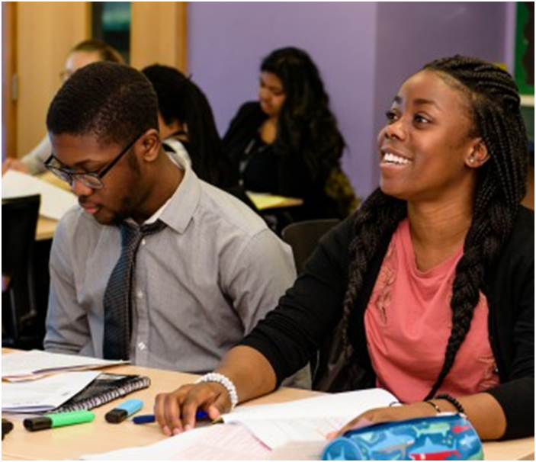

Subject Pre-requisites
P2 in a level 2 sport course (Sport Science at SMHS)/ Level 4 in GCSE PE
A keen interest in the following
Human anatomy
How the human body responds to exercise
The science behind coaching and learning new skills
Testing athletes performance
Responding to and treating sports injuries

Slide 3
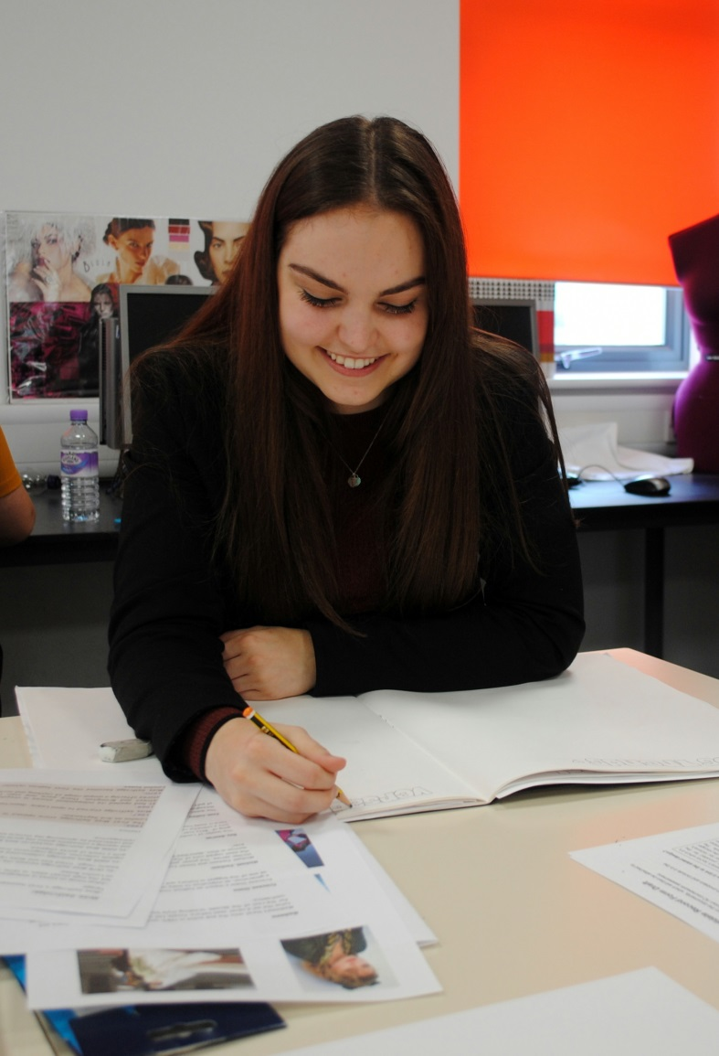
Course Breakdown
Diploma (2 A Levels)
(720 hours)
9 Units
6 Coursework Units
1 Exam
2 Controlled Assessments
Extended Certificate (1 A Level)
(360 hours)
4 units
2 coursework units
1 Exam
1 Controlled assessment

Slide 4
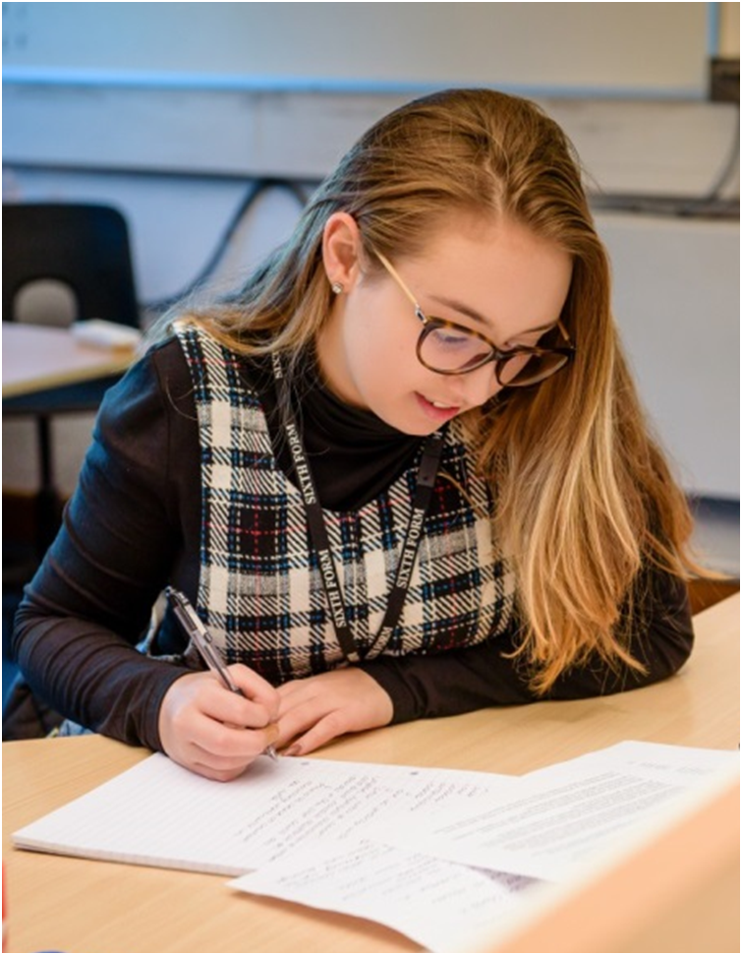
Course Breakdown: Component 1
  Unit 1 Examination
  Anatomy and Physiology
  5 topics
  1.5 hours
  80 marks
  Written examination marked externally

Slide 5
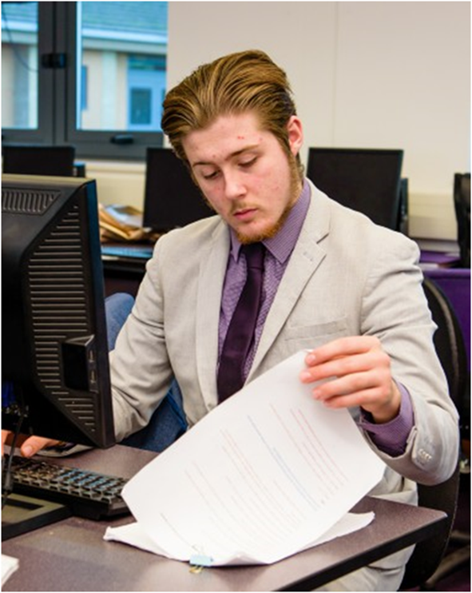
Course Breakdown Component 2
Unit 2
Fitness training and programming for health, sport and wellbeing
4 hours supervised research based around a scenario
2.5 hour written examination
60 marks
Marked externally

Slide 6

Course Breakdown: Component 3
Unit 22
Investigating business in the sport and active leisure industry
4 hours supervised research based around a scenario
2.5 hour written examination
60 marks
Marked externally

Slide 7

Mode of Study
The course is study using a combination of study methods.
1.) Teacher Led
2.) Group research tasks
3.) Independent completing of assignments
4.) Group presentations
5.) Small number of practical lessons
6.) Coaching of younger students

Slide 8
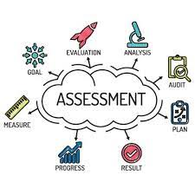
Mode of Assessment
External examinations
- Variety of short and long answer responses
- External supervised research
Coursework assignments
- Written
- Photographic and video evidence
- Witness statements

Slide 9
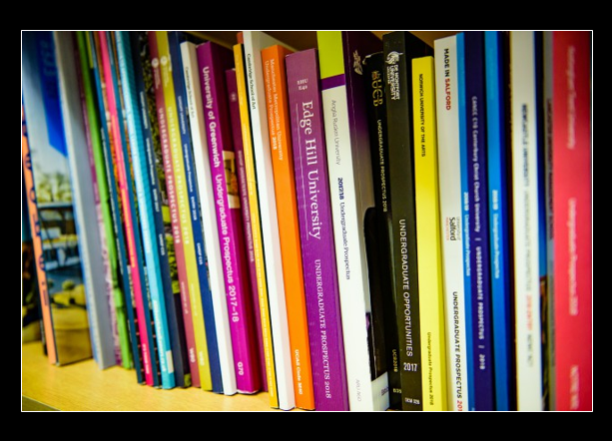
Post 18 Links
University Sport Pathways
Physiotherapy
Sport Science
Sports coaching
Strength and conditioning
Personal training
Sport Studies
Sports Coaching
Sports Journalism
Performance analysis

Slide 10

Follow us on @SMHSixth
‘Everyone is equal, everyone deserves the best’

