Slide 1
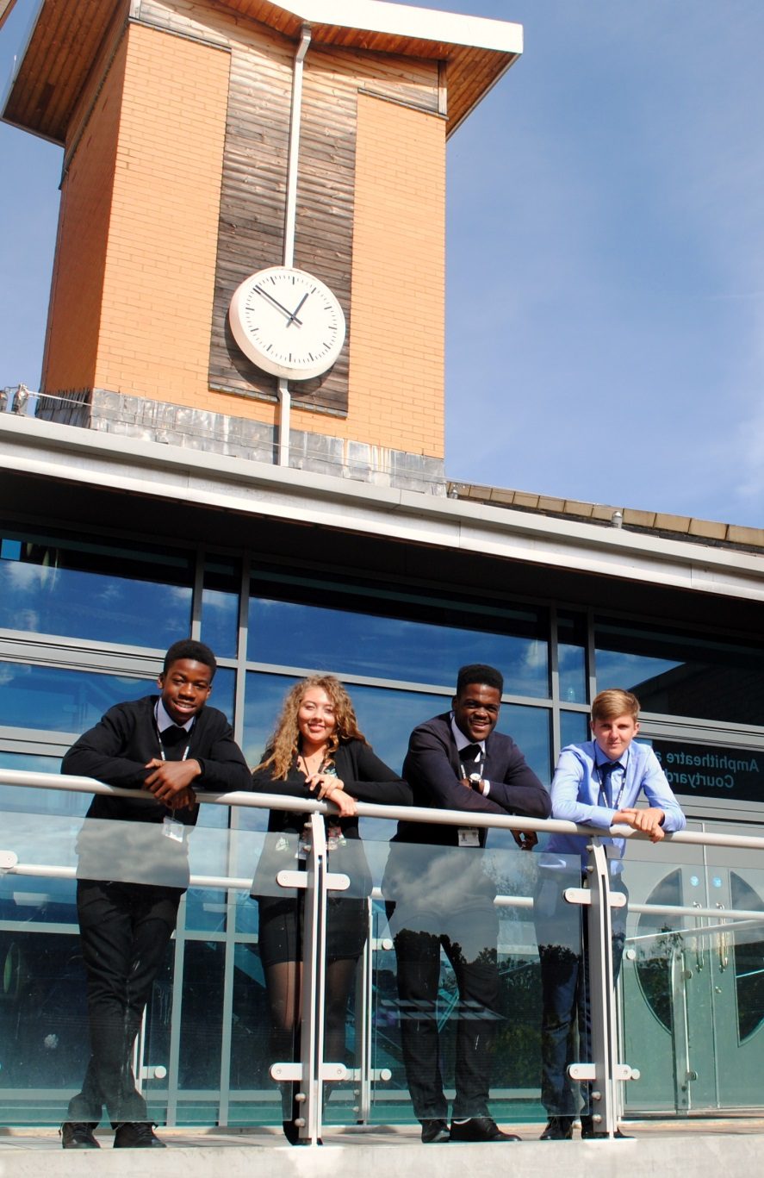
A Level History AQA 7042DO
St Mary’s Sixth Form & Leadership Centre
‘Everyone is equal, everyone deserves the best’

Slide 2
Subject Pre-requisites
A grade 4+ in English and in History.
An interest in History and current affairs.

Slide 3
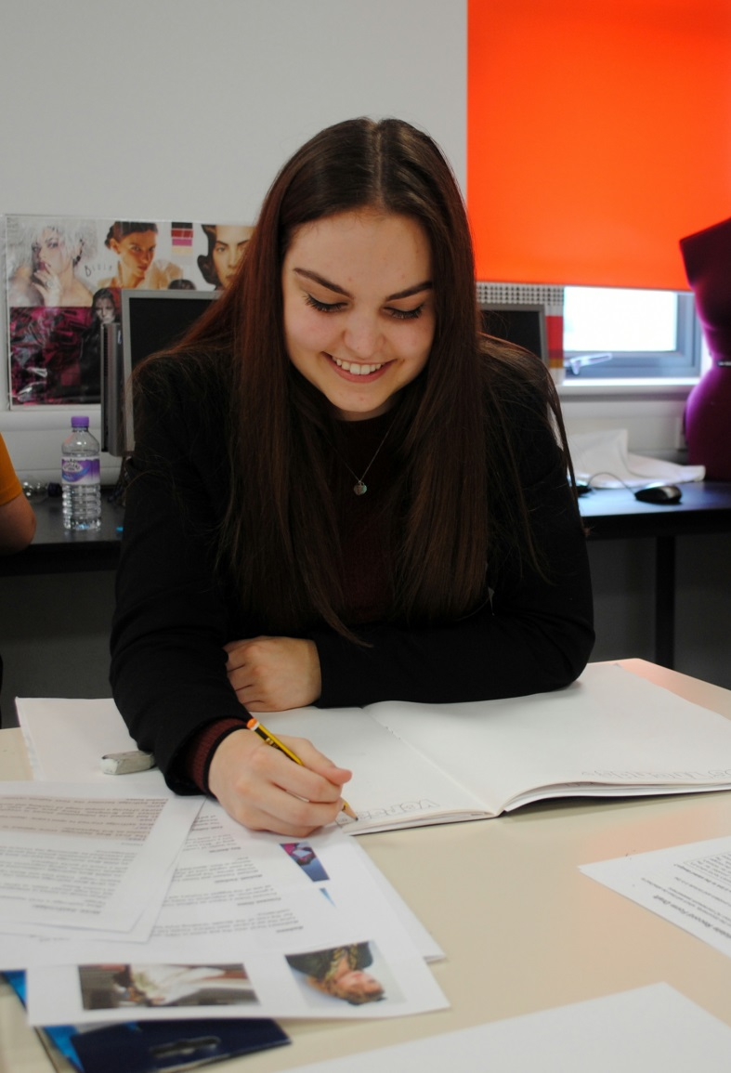
Course Breakdown
Component 1: Breadth of Study – The Stuarts, Britain and the Crisis of the Monarchy 1603-1702
Component 2: Democracy and Nazism; Germany 1918 – 1945
Component 3: Historical Investigation, focussing on 100 years of history and historians interpretation of why key changes have taken place

Slide 4
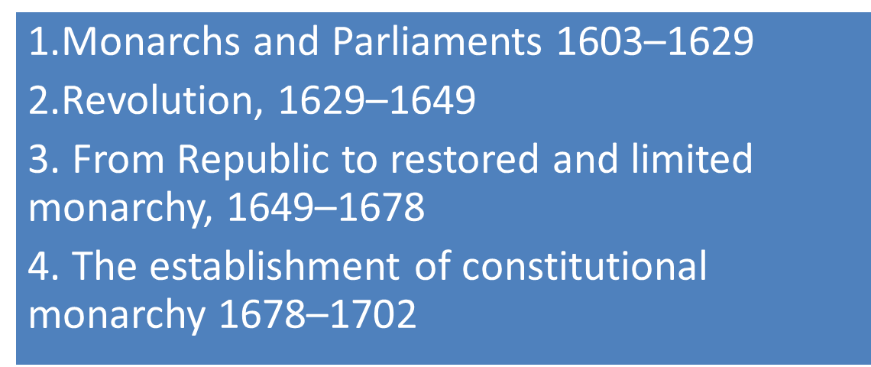
Course Breakdown: Component 1

Slide 5
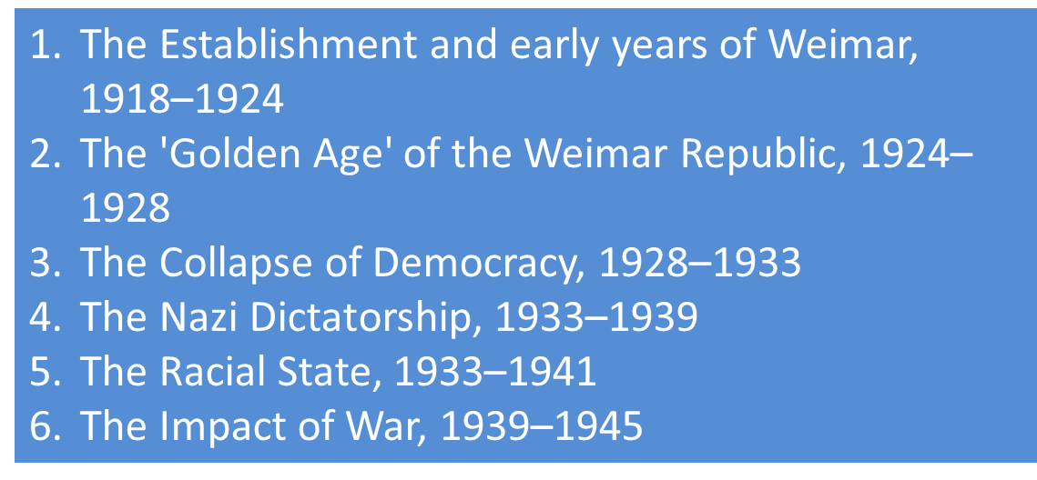
Course Breakdown Component 2

Slide 6
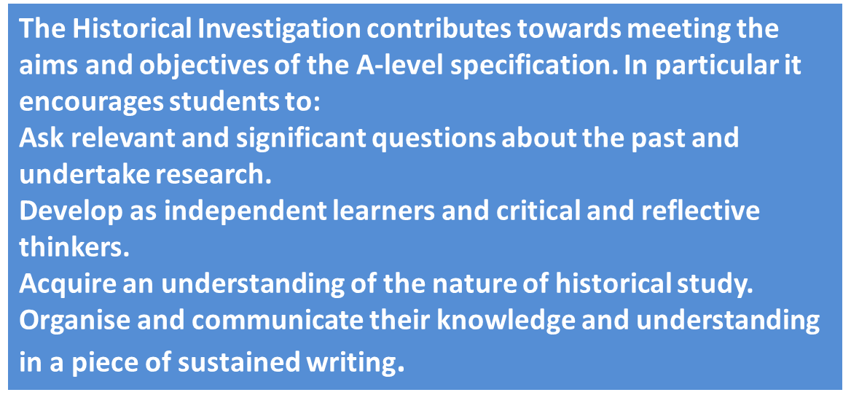
Course Breakdown: Component 3
Historical Investigation

Slide 7
Mode of Study
A-Level History requires you to participate in a variety of tasks. Your teacher will expect you to be fully committed to:
Group work
Presentations
Pre reading of articles
Note taking
Essay writing
Class discussion/debates
Exam skills

Slide 8
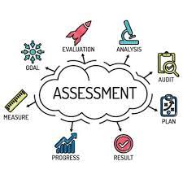
Mode of Assessment
The Stuarts, Britain and the Crisis of the Monarchy 1603-1702
Democracy and Nazism: Germany, 1918–1945
Historical Investigation
3500–4500 words
40 marks
20% of A-level
Marked by teachers
Moderated by AQA

Slide 9
Post 18 Links
History A Level allows you to communicate complex ideas. It gives you the opportunity to research in depth and develop independent work skills. All of these are highly desirable skills for jobs in education, HR, journalism, civil service and the media.
History A Level can lead to degrees in economics, history, international relations, politics and sociology at university.
Useful links for post 18:
https://www.history.org.uk/student/resource/2914/careers-in-history
https://www.theuniguide.co.uk/search/course?utf8=%E2%9C%93&c%5Bq%5D=History

Slide 10
Follow us on @SMHSixth
‘Everyone is equal, everyone deserves the best’

