Slide 1
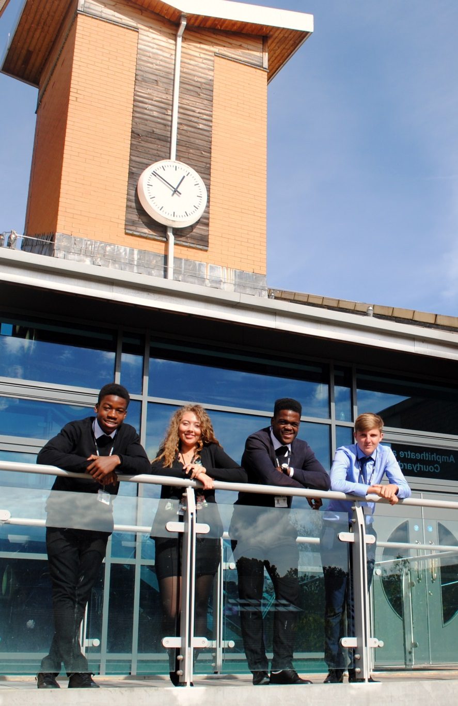
A Level Geography Edexcel 9GE0
St Mary’s Sixth Form & Leadership Centre
‘Everyone is equal, everyone deserves the best’

Slide 2
Subject Pre-requisites
In order to study A level geography you must have GCSE grade 5 or higher in Geography and maths.
You should have an interest in finding out about the world, how it works and how we can make a difference.

Slide 3
Course Breakdown
Unit 1: Dynamic Landscapes - Tectonic Processes and Hazards/ Coastal Landscape Systems, Processes and Change /The Water Cycle and Water Insecurity/The Carbon Cycle and Energy Security
Unit 2: Dynamic Places – Globalisation/ Shaping Places – Regenerating Places /Superpowers/ Migration Identity and Sovereignty
Unit 3: Synoptic Themes - assessment of geographical skills, knowledge and understanding within a place based context linking players, attitudes and actions, and futures and uncertainties.
Unit 4: Independent Investigation

Slide 4
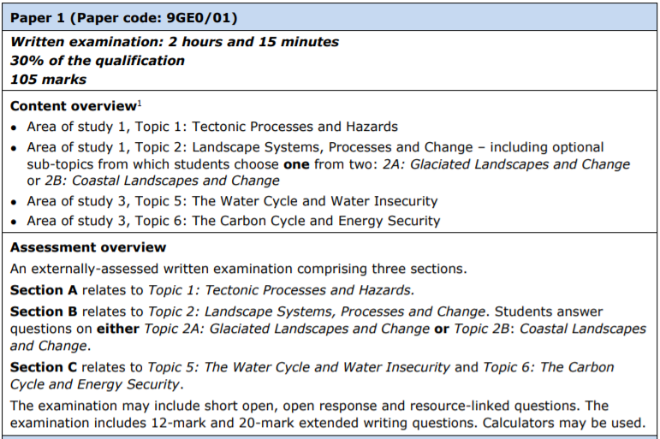
Course Breakdown: Component 1

Slide 5
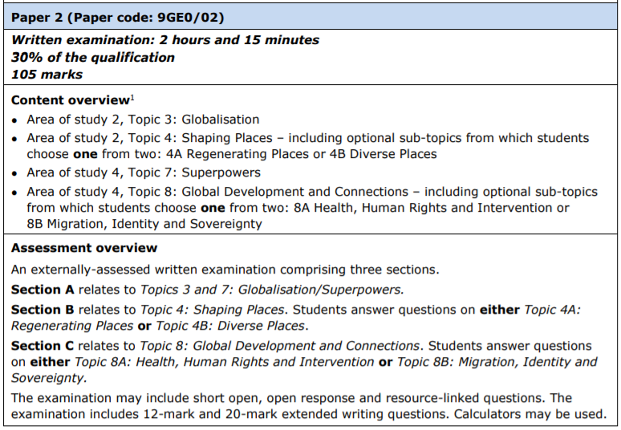
Course Breakdown: Component 2

Slide 6
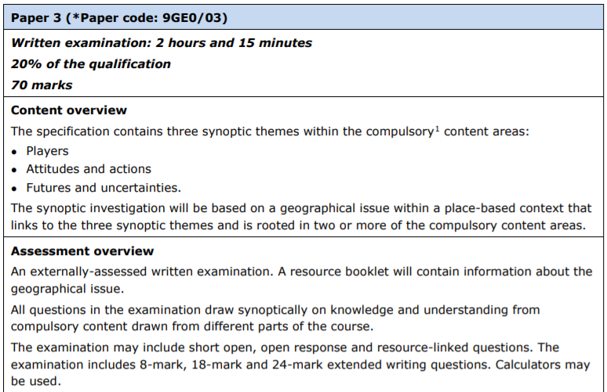
Course Breakdown: Component 3
Notes:
All students joining the sixth form are entitled to a number of items that will support their learning.

Slide 7
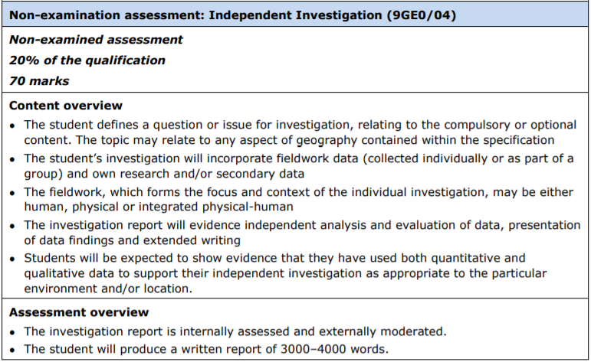
Course Breakdown: Component 4

Slide 8
Mode of Study
In lessons you will have a range of learning activities including: Class discussion, decision making tasks, reading articles, watching videos, note taking and more
You will complete 4 days of compulsory fieldwork
Each week you will have homework set which links to the different course components
You will be expected to read books such as Disaster by Choice: How Our Actions Turn Natural Hazards Into Catastrophes by Ilan Kelman

Slide 9
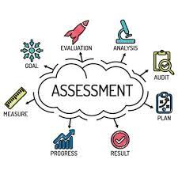
Mode of Assessment
You will have 3 exams at the end of year 13 and a Non-examined element which is based around your independent data collection and research.
Throughout the course you will do regular exam question practice as well as the formal exams and assessments.

Slide 10
Post 18 Links
With the growing importance of issues such as climate change, migration, environmental degradation, spatial epidemiology and inequalities, geography is one of the most relevant courses you could choose to study. Geography courses are popular, demonstrated by strong completion rates and positive student feedback. Geographers are also highly employable and collectively receive competitive graduate salaries. Above all, geographers have potential to be well-informed global citizens, using their unique combinations of knowledge and skills to make a positive difference in the world.
Whatever your passion for the world – fascination with landscapes or concerns about sustainability – geography will provide you with knowledge and transferable skills that will reward you personally and advance you professionally.
The benefits of a geography degree continue well beyond graduation. Geography is placed among the top subjects for graduate earnings.
Geography is also a facilitating subject meaning that it can open doors to a range of degrees at the most selective universities.

Slide 11
Follow us on @SMHSixth
‘Everyone is equal, everyone deserves the best’

