Slide 1
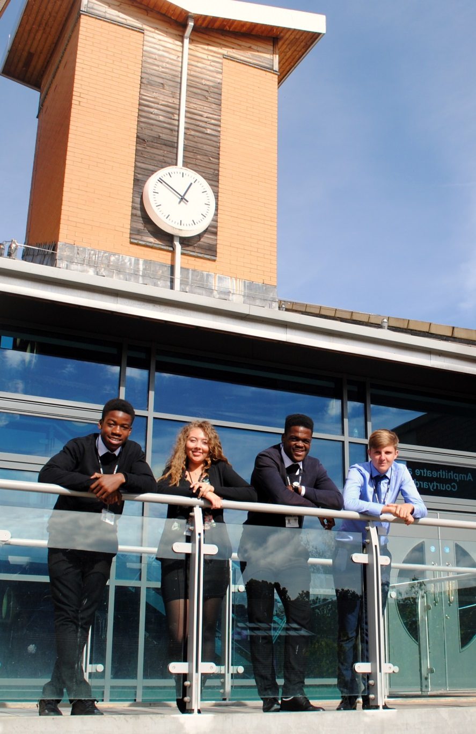
A Level Mathematics Edexcel 9MA0
St Mary’s Sixth Form & Leadership Centre
‘Everyone is equal, everyone deserves the best’

Slide 2
Subject Pre-requisites
Having an interest in mathematics is important for success
There are a wealth of excellent quality maths content creators on youtube such as:
3blue1brown
Standupmaths
Numberphile

Slide 3
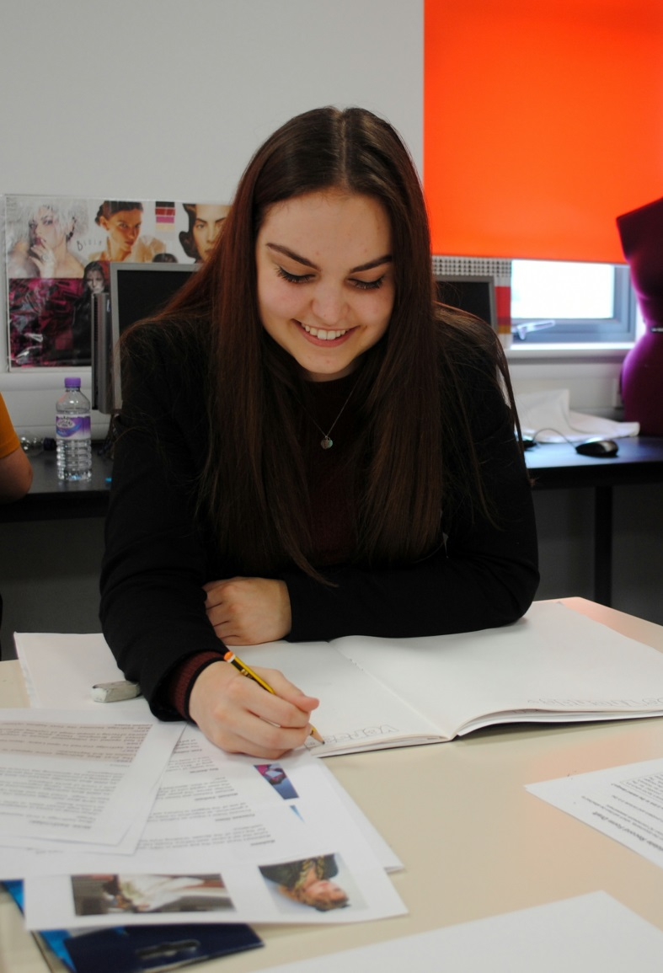
Course Breakdown
The Pearson Edexcel Level 3 Advanced Subsidiary GCE in Mathematics consists of two externally-examined papers. Students must complete all assessment in May/June in any single year.

Slide 4
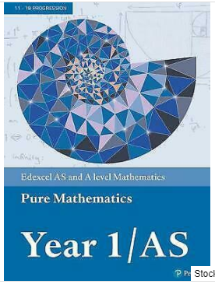
: Textbook
Notes:
All students joining the sixth form are entitled to a number of items that will support their learning.

Slide 5
You will have a formula booklet

Slide 6
Mode of Study
A level maths will require large amounts of independent study
We do research related to the course of eg. Pascal triangles
We encourage group studies alongside individual effort
We have drop-in sessions to support learning
You will be given weekly tasks
We pose challenges outside of the daily lessons
Students will have access to online resources from Hegarty and AMSP
Homework is set weekly
You are expected to work ahead

Slide 7
Mode of Assessment

Slide 8
Mode of Assessment part 2

Slide 9
Post 18 Links
With no bias or particular preference, this links shows some Mathematics related courses you could pursue at university
https://search.qmul.ac.uk/s/search.html?collection=queenmary-coursefinder-undergraduate-meta&query=mathematics

Slide 10
Follow us on @SMHSixth
‘Everyone is equal, everyone deserves the best’

