Slide 1
Chicken Tikka Masala with Rice, Cauliflower, Naan Bread & Mango Chutney
Sausage Mashed Potatoes, Broccoli, Carrots & Gravy
BBQ Chicken with
Wedges, Mixed Salad & Coleslaw
Meatballs in Tomato Sauce with Spaghetti, Green Beans & Sweetcorn
Fishcake with Chips & Garden Peas or Baked Beans
Roast Vegetable Pasta Bake, Green Beans & Sweetcorn
Vegetable Wellington Potatoes Broccoli, Carrots & Gravy
Vegetable Korma with Rice, Cauliflower, Naan Bread, &
Mango Chutney
NEW Loaded Veg Chilli Nachos with Tomato & Onion Salsa
NEW Spicy Bean Burger with Wedges, Mixed Salad & Coleslaw
Chicken Wings
Chicken Wrap
Sausage Roll
Bacon & Cheese Flatbread
Veggie Pitta Pizza
Pasta bar with Beef Meatballs
Vegetarian
Noodle Street
Pasta Kitchen
Loaded Nachos
Pasta Kitchen
Iced Sponge
Summer Fruit Crumble with Custard
Vanilla Shortbread
Carrot Cake
Oaty Flapjack

Slide 2
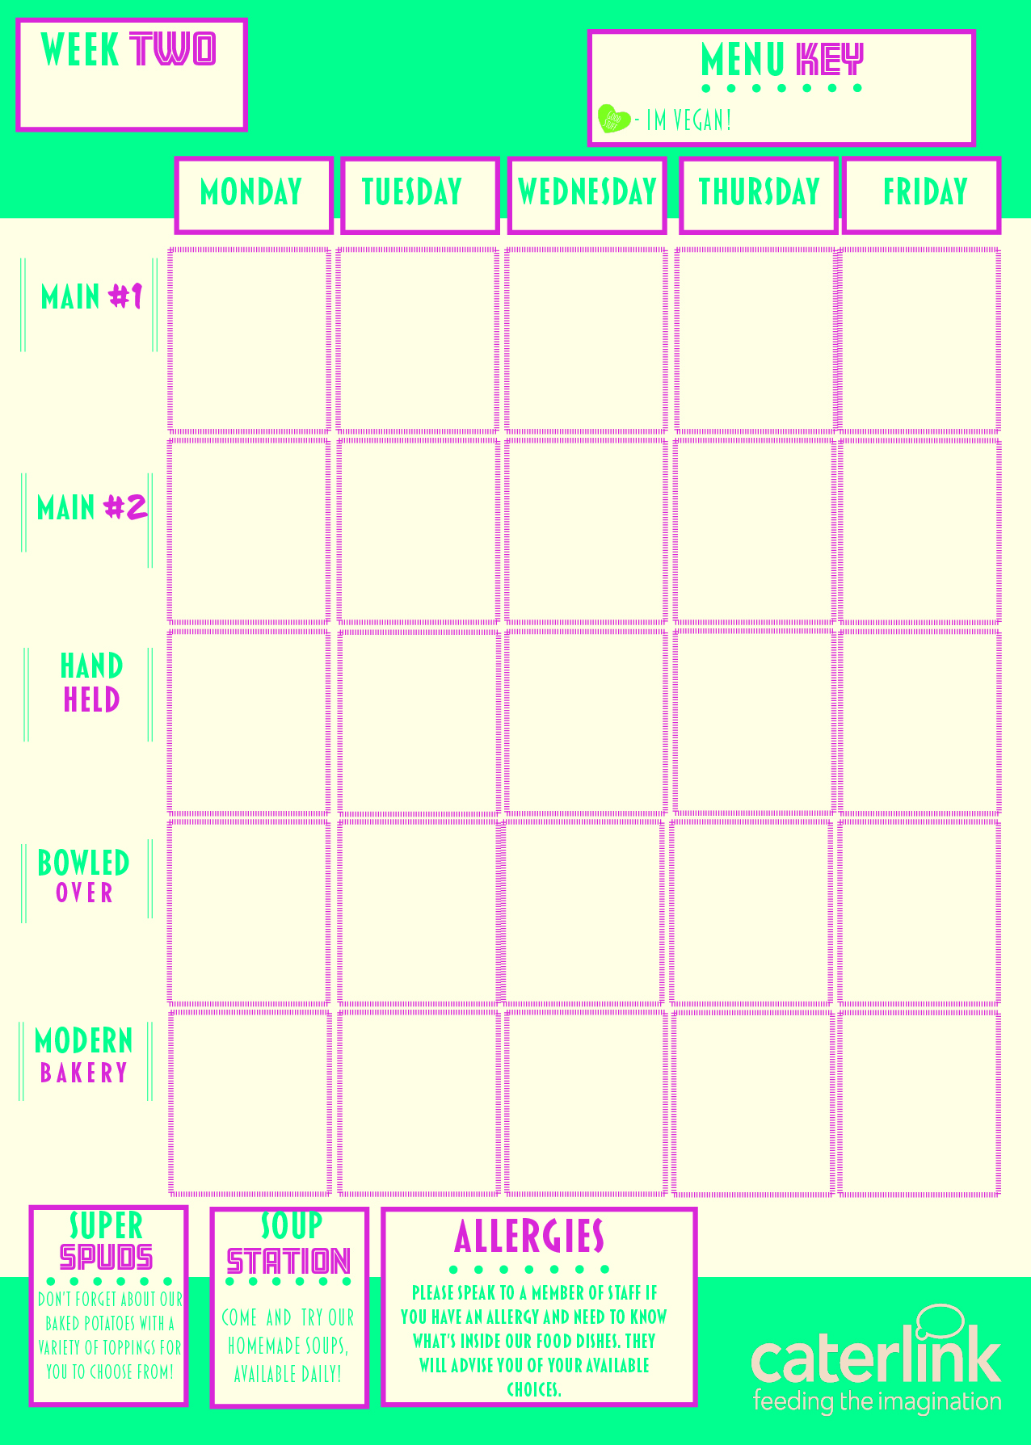
Spicy Chicken Open Wrap with Paprika Wedges, Mixed Salad & Coleslaw
Chilli Con Carne with
Rice, Sweetcorn & Nachos
Roast Chicken, Roast Potatoes, Carrots, Cabbage & Gravy
Chicken Korma with
Rice, Broccoli & Naan Sliders
Burger & Chips Day
NEW Vegetarian Spicy Mexican Rice with Sweetcorn & Nachos
Tomato & Basil Pasta with Roasted Vegetables
Veggie Burger
with Chips & Garden Peas
Roast Vegetable Wrap with Paprika Wedges, Mixed Salad & Coleslaw
Lentil Dahl with
Rice, Broccoli & Naan Sliders
Selection of Paninis
Chicken Wrap
Sausage Roll
Bagel Pizza
Chick
en Quesadilla
Pasta Kitchen
Noodle Street
Pasta Kitchen
Rice Bowl
Loaded Nachos
Chocolate Orange
Cake
Pineapple Upside
Down Cake
Orange and Lemon Cake
NEW Apple Pie
with Cream
Chocolate Brownie

Slide 3
Crunchy Crouton Mac & Cheese with Sweetcorn & Mixed Salad
Spaghetti Bolognaise with either Salad or Corn
Tandoori Chicken Naan with Bombay Potatoes & Green Beans
Peri-Peri Chicken Wrap with Spicy Rice & Coleslaw
Fish, Chips & Garden Peas or Baked Beans
Boston Bean Mac & Cheese with Sweetcorn & Mixed Salad
BBQ Quorn with Spicy Rice & Coleslaw
Spinach Butternut & chickpea Stew with Rice and vegetables
Sweet Potato, Chickpea & Spinach Curry with Rice & Green Beans
Vegetable Spring rolls with Chips & Garden Peas or Baked Beans
Pitta Pizza
Selection of Paninis
Selection of Wraps
Chicken Wrap
Sausage Roll
Pasta Kitchen
Rice Bowl
Pasta Kitchen
Noodle Street
Pasta Kitchen
NEW Cornflake Tart
Home Made
Muffins
Chocolate
Brick wall Cake
Bread Pudding with Custard
Banana Loaf

